Slide 1

Investigating the distribution of Legionella in urban and suburban Hudson River watersheds
Zoom Pop-out here
Queens College Advisor: Greg O’Mullan
Tibor T. Polgar Fellowship Project Fall 2020
Thursday , January 21st, 2021
Azlan maqbool

Slide 2

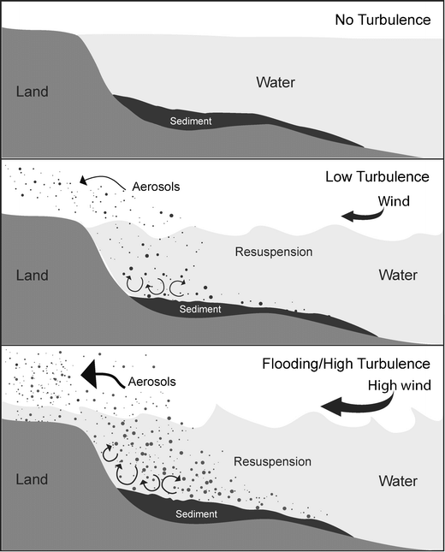
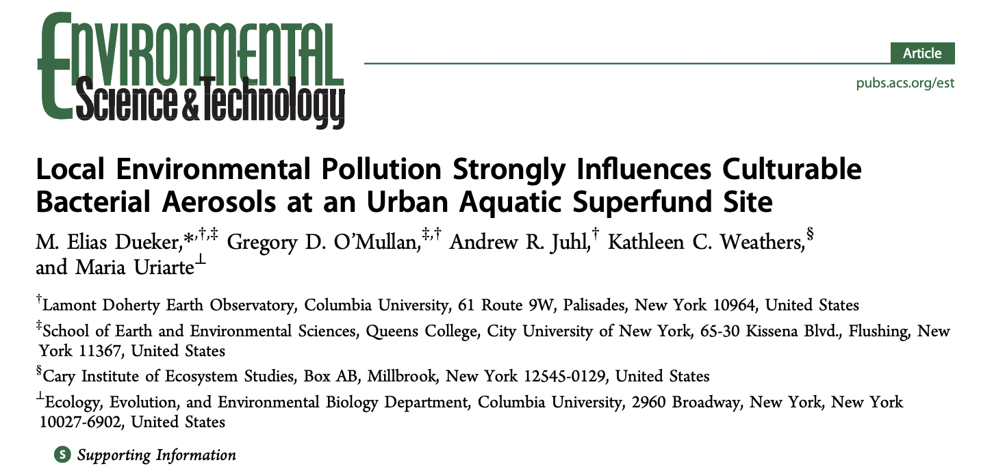
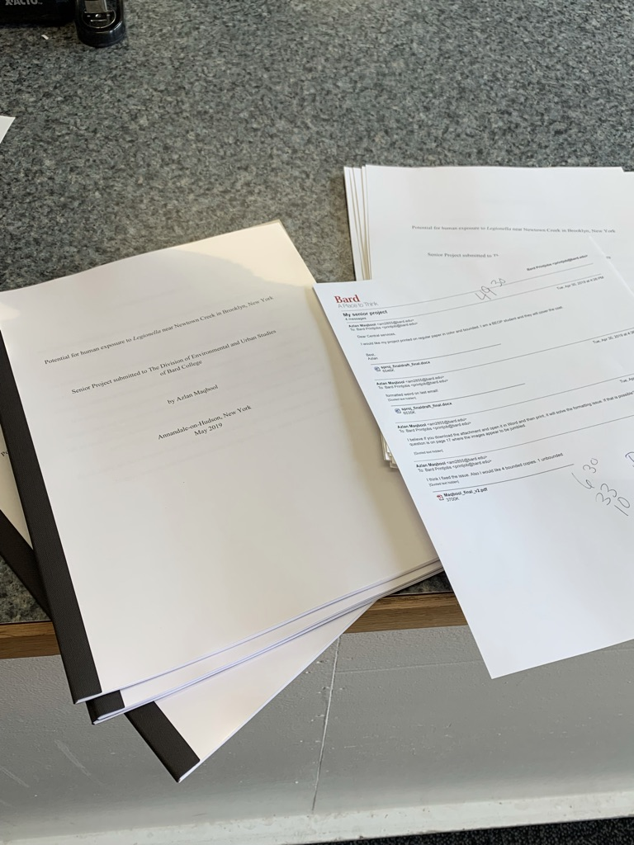



What led me to study Legionella?
Zoom Pop-out here
Interested in microbial interactions in the air + water interface.
(Dueker et al. 2012; HRF funded)
Legionella found in metagenomics in water samples in NYC tributary waterways
Senior Thesis: Work with impactor and bioaerosols
Queens College, School of Earth and Environmental Science

Slide 3
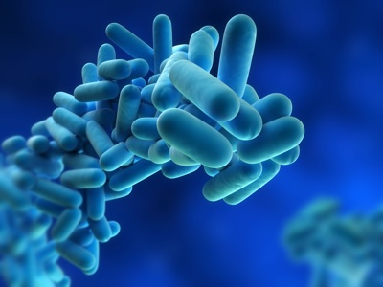

What is Legionella? Why L. pneumophila?
Zoom Pop-out here
Legionella is gram-negative bacteria that became known after its identification following an outbreak in 1976 at an American Legion conference hotel.
Of the 58 Legionella species that have been described in published articles, about 25 are linked to disease.
Legionella pneumophila is the species causing the majority of infections (Muder et al 2002).
Notes:
In transition to next slide, begin to explain stormwater connection.
L. pneumophila has been reported to have a widespread environmental distribution. Several studies have confirmed a ubiquitous presence in soils, lakes, and man-made water systems (van Heijnsbergen 2015; Declerck et al. 2007; Steele et al. 1990; Fliermans et al. 1981).
Currently, management is focused on cooling towers, Legionella is known to have a much broader environmental distribution (Prussin et al 2017) and very little research or monitoring has assessed the other potential environmental reservoirs of pathogenic Legionella.

Slide 4
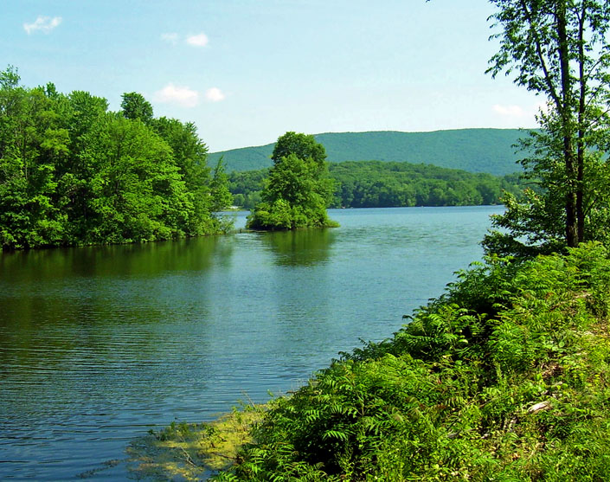
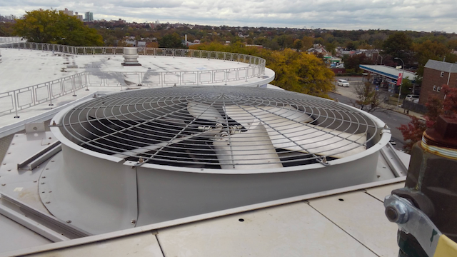
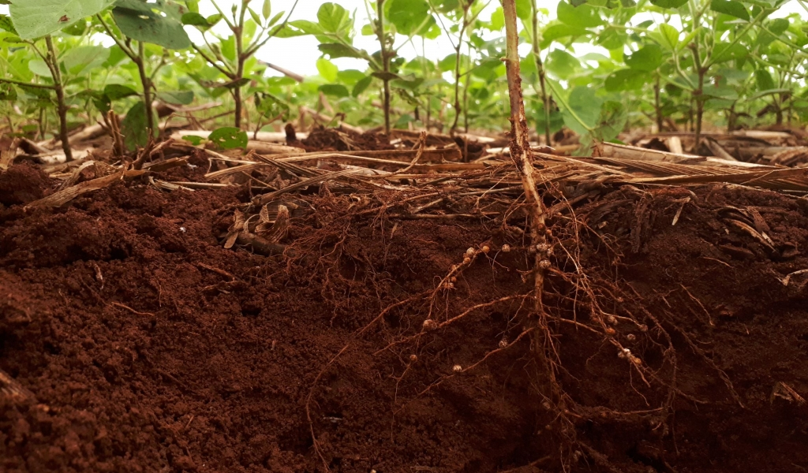
Legionella Environmental Distribution
Zoom Pop-out here
While most people think of Legionella in terms of an airborne pathogen, it has been reported to have a widespread environmental distribution...
Several studies have confirmed a widespread presence in
Soil
Lakes
Man-made water systems
van Heijnsbergen 2015; Declerck et al. 2007; Steele et al. 1990; Fliermans et al. 1981.
Notes:
In transition to next slide, begin to explain stormwater connection.
L. pneumophila has been reported to have a widespread environmental distribution. Several studies have confirmed a ubiquitous presence in soils, lakes, and man-made water systems (van Heijnsbergen 2015; Declerck et al. 2007; Steele et al. 1990; Fliermans et al. 1981).
Currently, management is focused on cooling towers, Legionella is known to have a much broader environmental distribution (Prussin et al 2017) and very little research or monitoring has assessed the other potential environmental reservoirs of pathogenic Legionella.

Slide 5
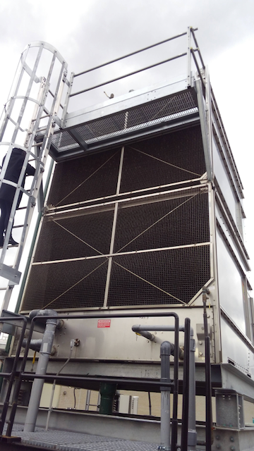
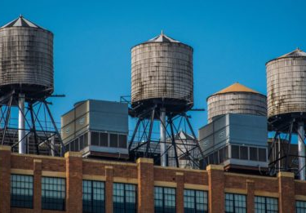
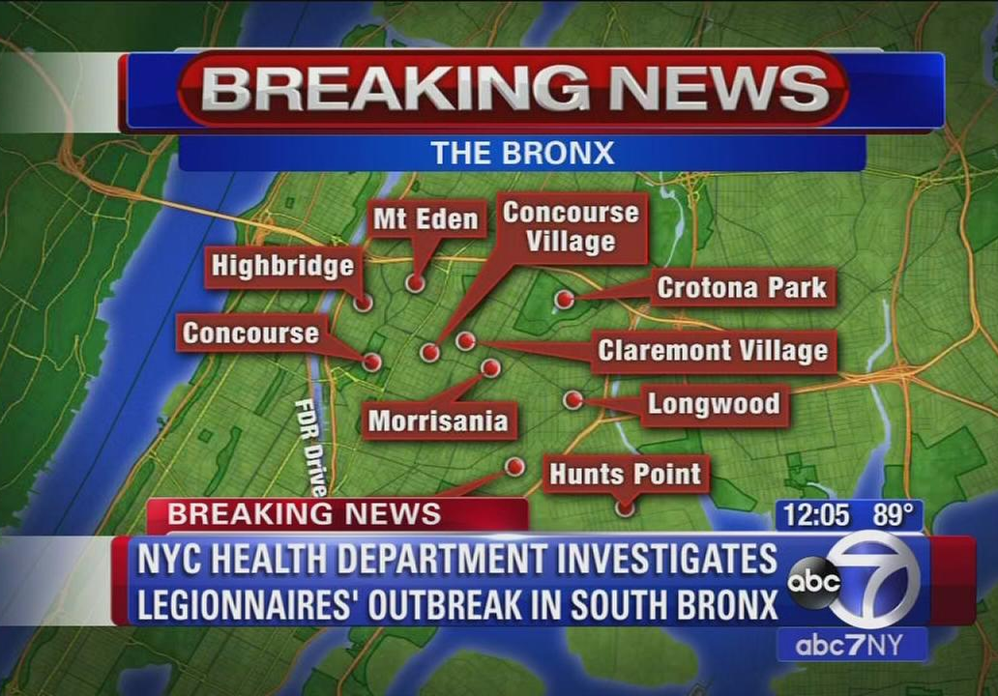
New York City Legionnaires Disease Outbreak
Zoom Pop-out here
The relevance of Legionella is especially important in the state of New York.
In the 2015 outbreak, there was a total of 138 cases and 16 deaths, making it the largest LD outbreak in NYC history.
After the identification of cooling towers as the culprit, Local Law 77, was enacted in August 2015.
What are other reservoirs?
Notes:
A 2017 case study found that the state of New York reports approximately 50% of all the cases of LD in the entire country despite making up only 6% of the population (Prussin et al. 2017)

Slide 6
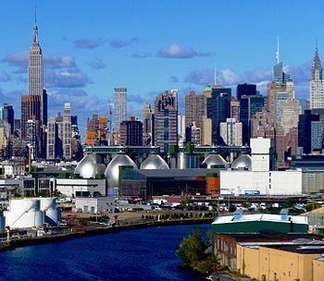
Relevance of Wastewater Treatment Plants
Zoom Pop-out here
The number of municipal wastewater facilities worldwide has drastically increased as a result of growing population numbers.
WWTPs create conditions conducive to Legionella proliferation.
In a 2018 study, found that these facilities may play an important role in local or community transmission of Legionella.
Coming to QC where the urban distribution of sewage related microbes was already underway, I wanted to investigate the distribution of Legionella....

Slide 7
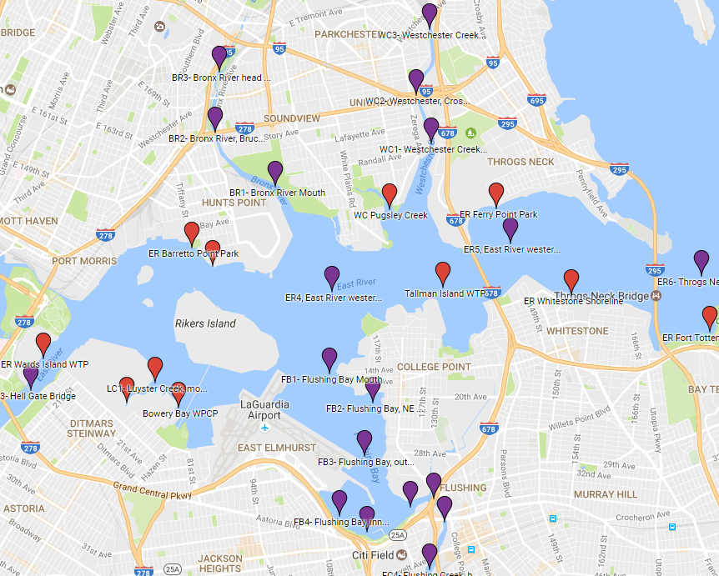
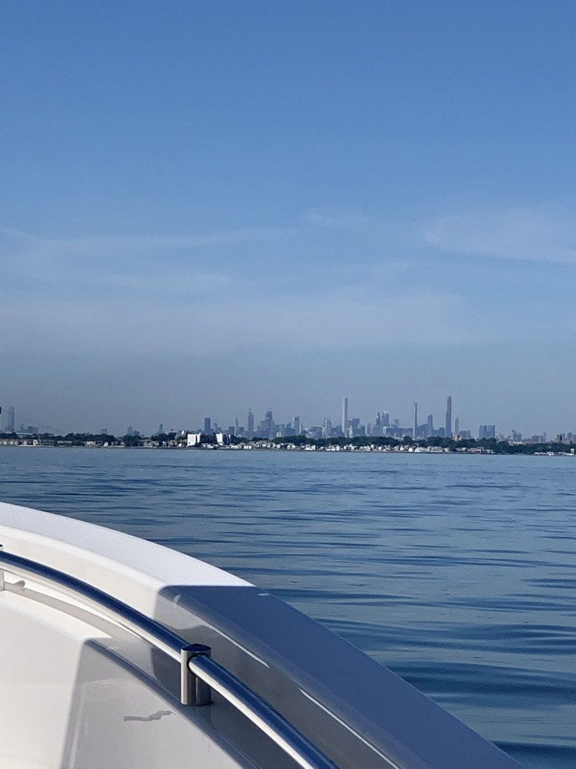
Is Legionella occurrence connected to patterns of sewage in the urban coastal environment?
Zoom Pop-out here
22 sampling sites
  15 Estuarine
4-month sampling period
Site Measurements
Measured dissolved oxygen
Temperature
Salinity
Laboratory Assays
Legiolert – to identify L. pnuemophila
Enterolert – to identify enterococcus
Strerivex filtered samples for DNA analysis
East River and Western Long Island Sound
Notes:
Significance --No prior work done to connect Legionella to sewage impacted waters.

Slide 8
Is Legionella occurrence connected to patterns of sewage in the urban coastal environment?
Zoom Pop-out here
22 sampling sites
  15 Estuarine
In estuary, we found a positive correlation between FIB and Legionella (Spearman r= 0.538, p<0.01)
We detected L. pnuemophila in 51% of estuarine samples. The bacteria were mainly found in low levels.
Notes:
Significance --No prior work done to connect Legionella to sewage impacted waters.

Slide 9
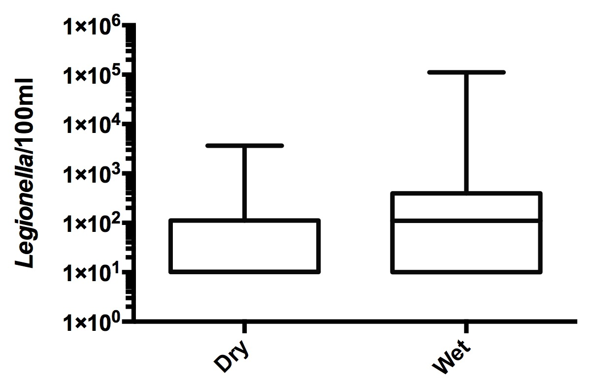
Is Legionella occurrence connected to patterns of sewage in the urban coastal environment?
Zoom Pop-out here
22 sampling sites
  15 Estuarine
NYC Estuary Wet vs Dry
Wet is significantly different than dry, p=0.048 (Mann-Whitney)
Notes:
Significance --No prior work done to connect Legionella to sewage impacted waters.

Slide 10
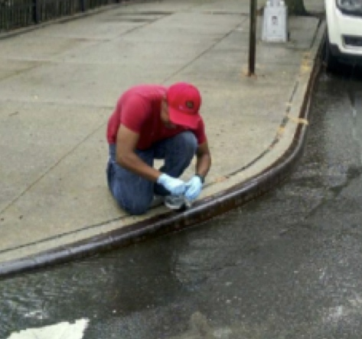
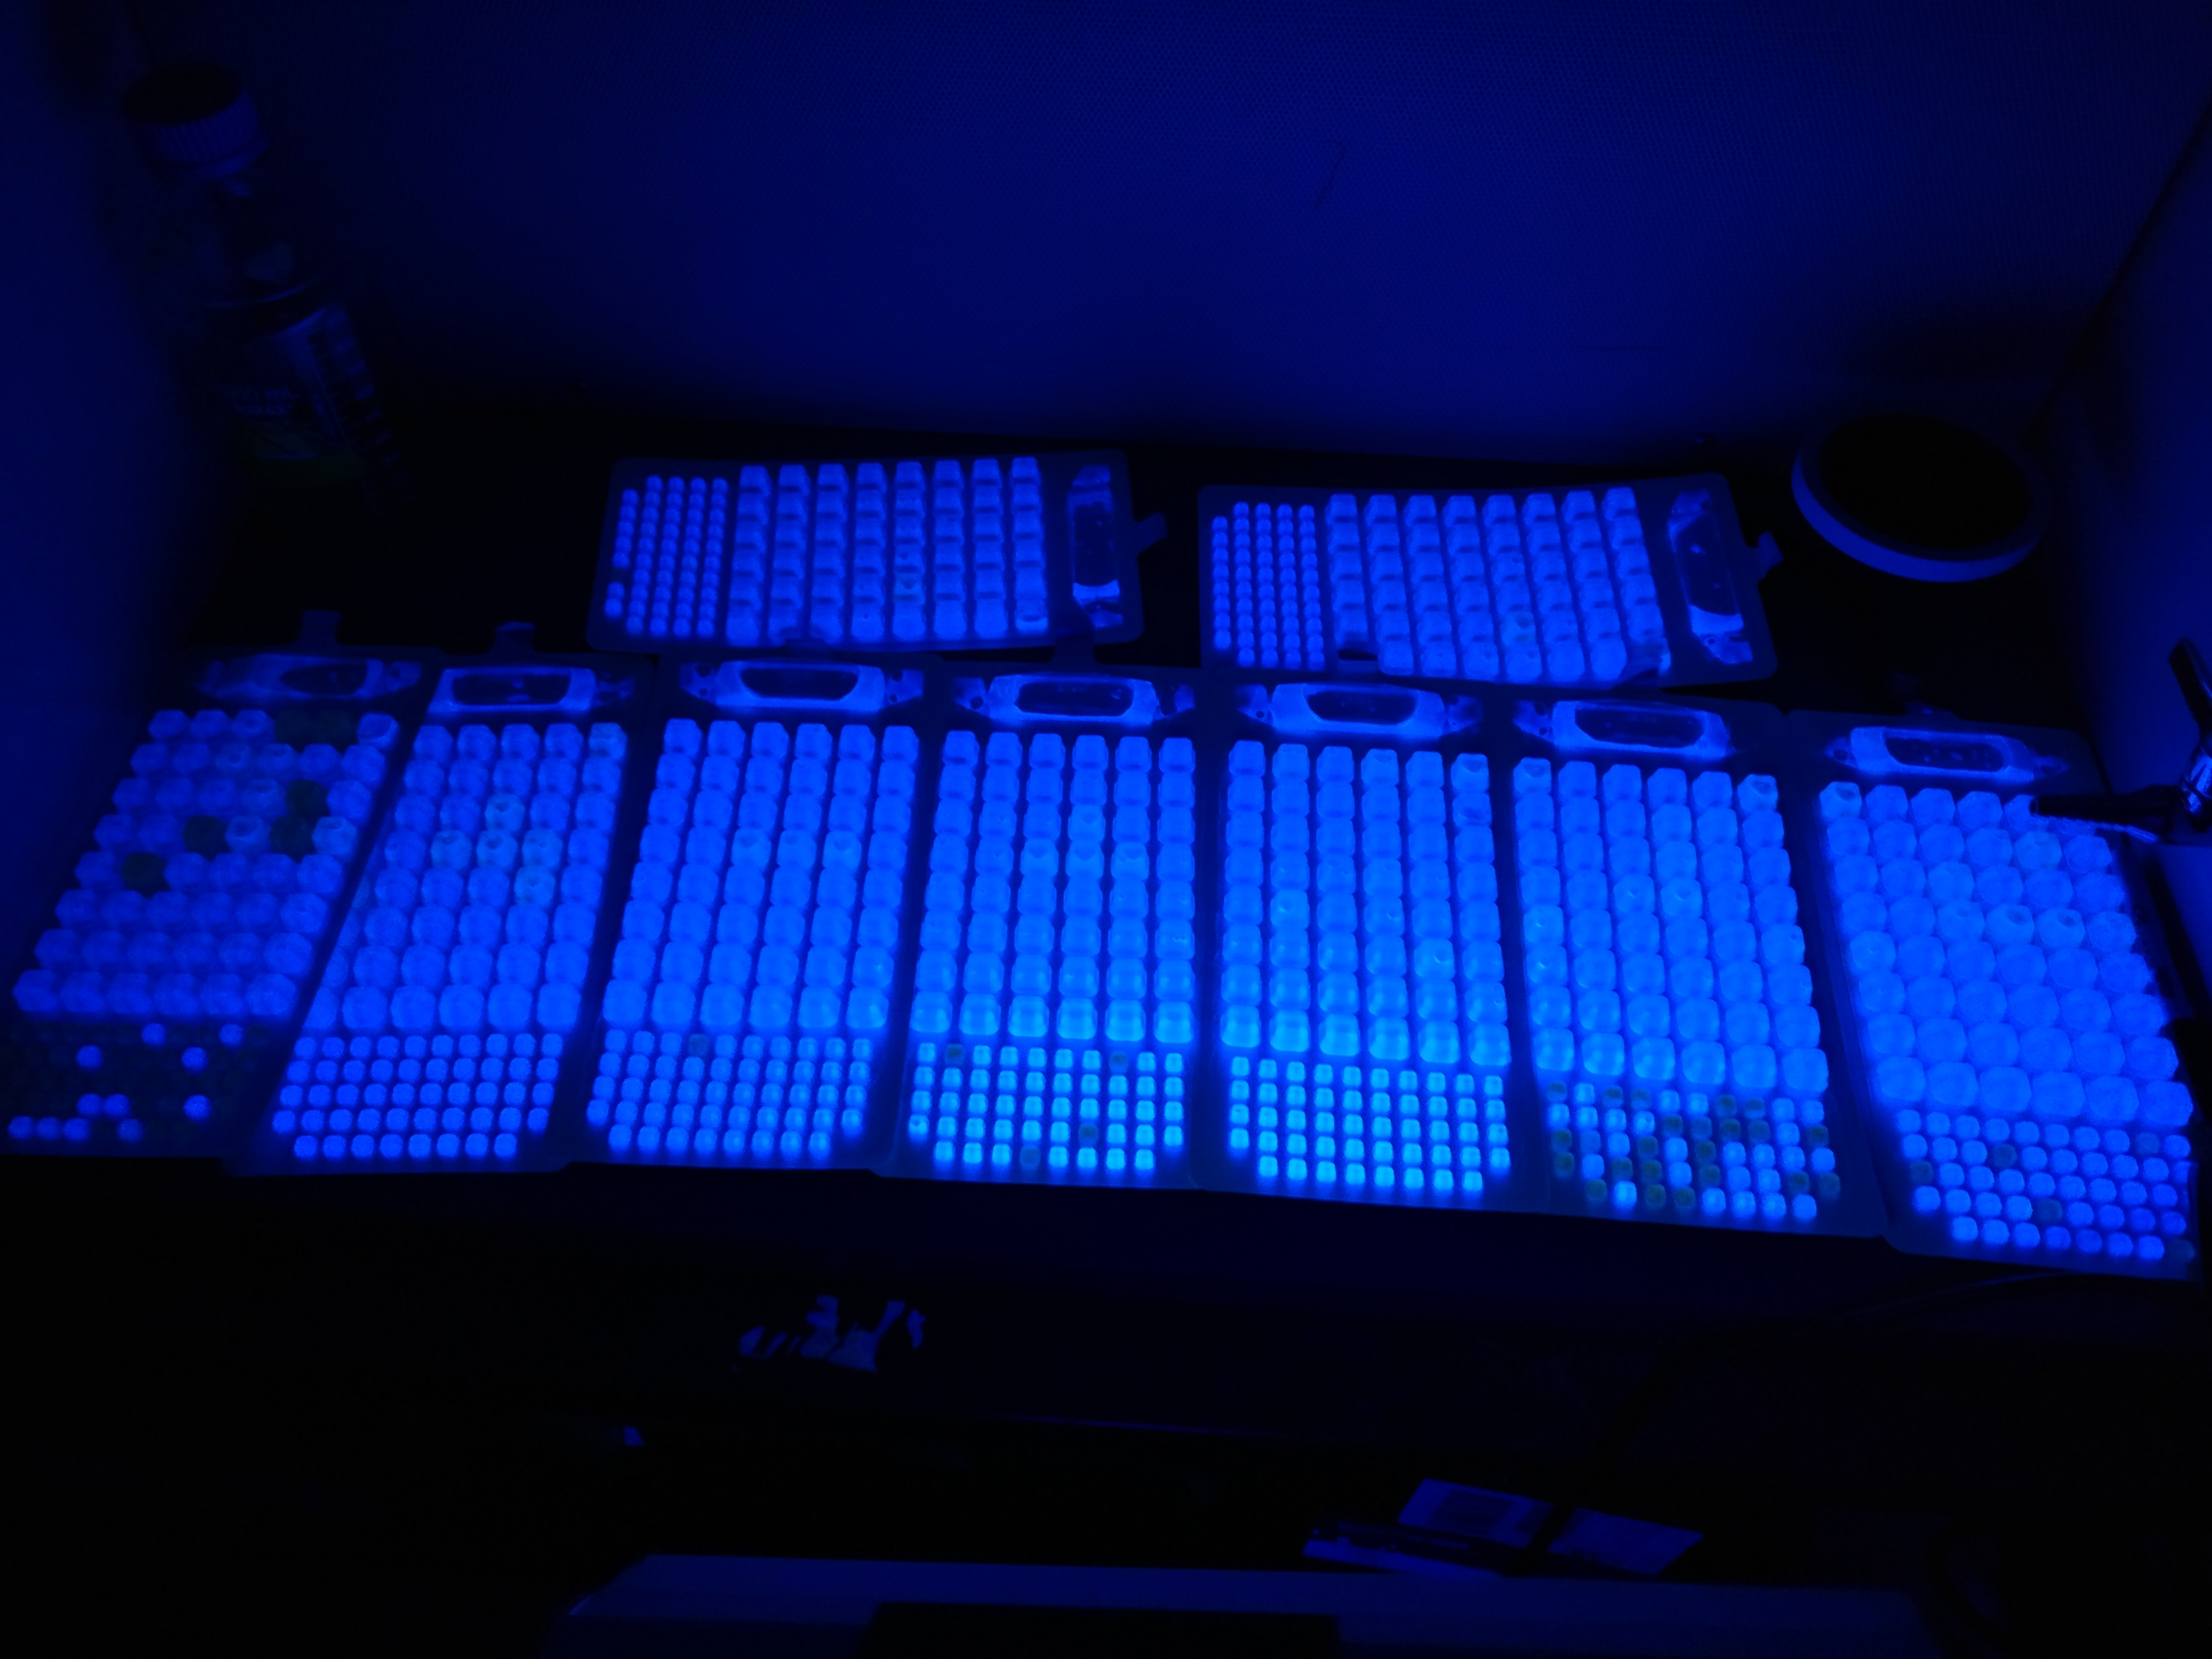
Urban street water can act as a major FIB source to waterways
Angel Montero - Polgar Fellow
Zoom Pop-out here
FIB were abundant in all 69 urban street water samples, collected across 10 locations.
Median FIB concentration was more than 2 orders of magnitude above EPA-BAV
Slide courtesy of Angel Montero
Notes:
Significance --No prior work done to connect Legionella to sewage impacted waters.

Slide 11
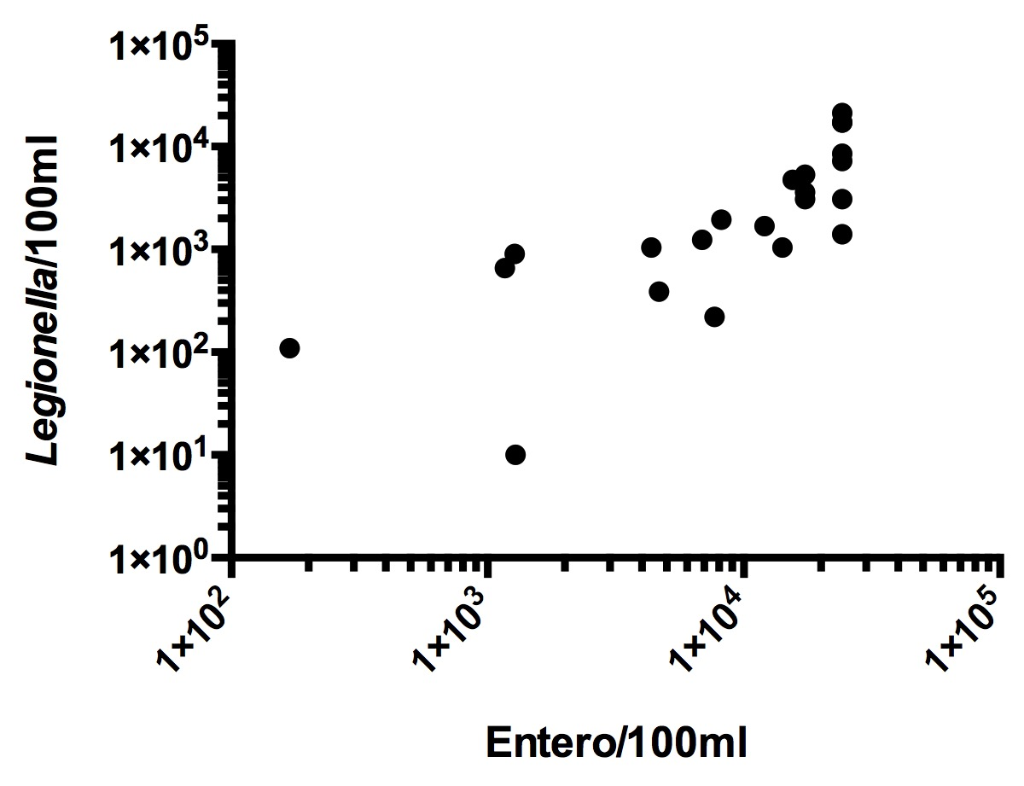
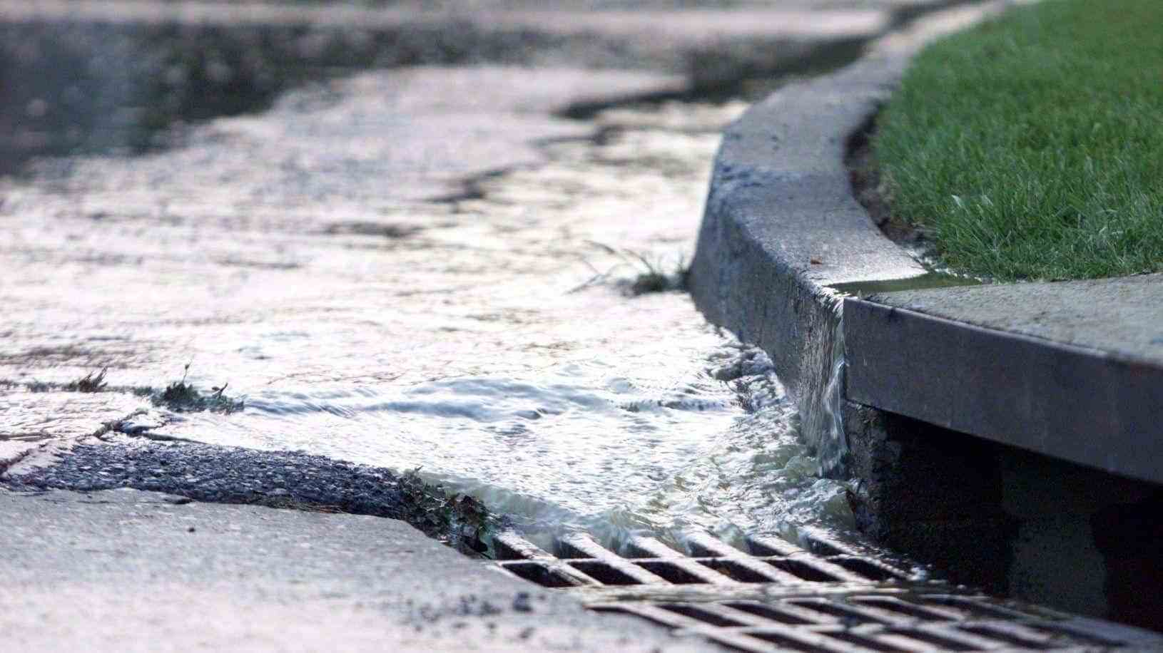
Is Legionella occurrence connected to patterns of sewage in the urban coastal environment?
Zoom Pop-out here
22 sampling sites
  15 Estuarine
  5 Street
NYC street scatterplot
Spearman r= 0.861, p<0.01
Notes:
Significance --No prior work done to connect Legionella to sewage impacted waters.

Slide 12
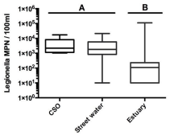
Is Legionella occurrence connected to patterns of sewage in the urban coastal environment?
Zoom Pop-out here
22 sampling sites
  15 Estuarine
  5 Street
  2 CSO
NYC Source Comparison
Street and CSO not different
Estuary significantly different than both street and CSO, p<0.01 (Kruskal-Wallis)
The max value came on a wet weather event at an estuarine site close to BB08, one of NYC largest CSO pipes.
Notes:
Significance --No prior work done to connect Legionella to sewage impacted waters.

Slide 13
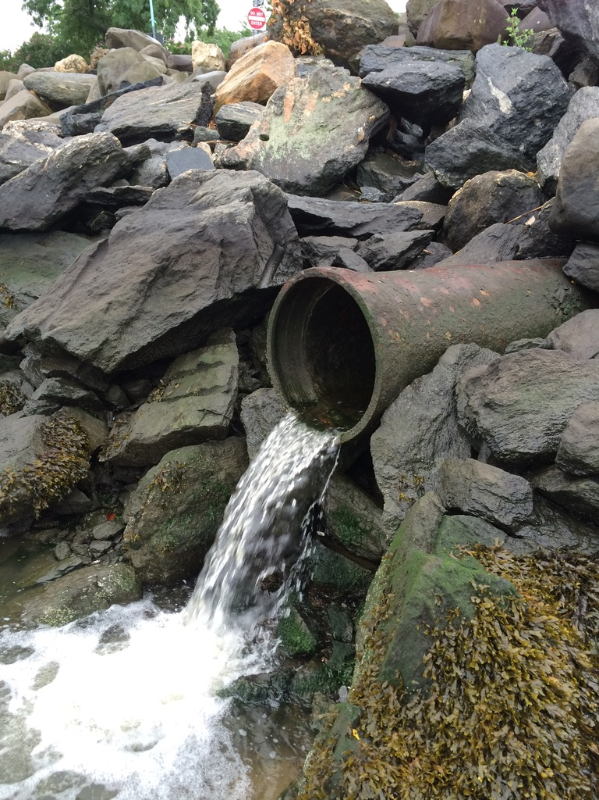
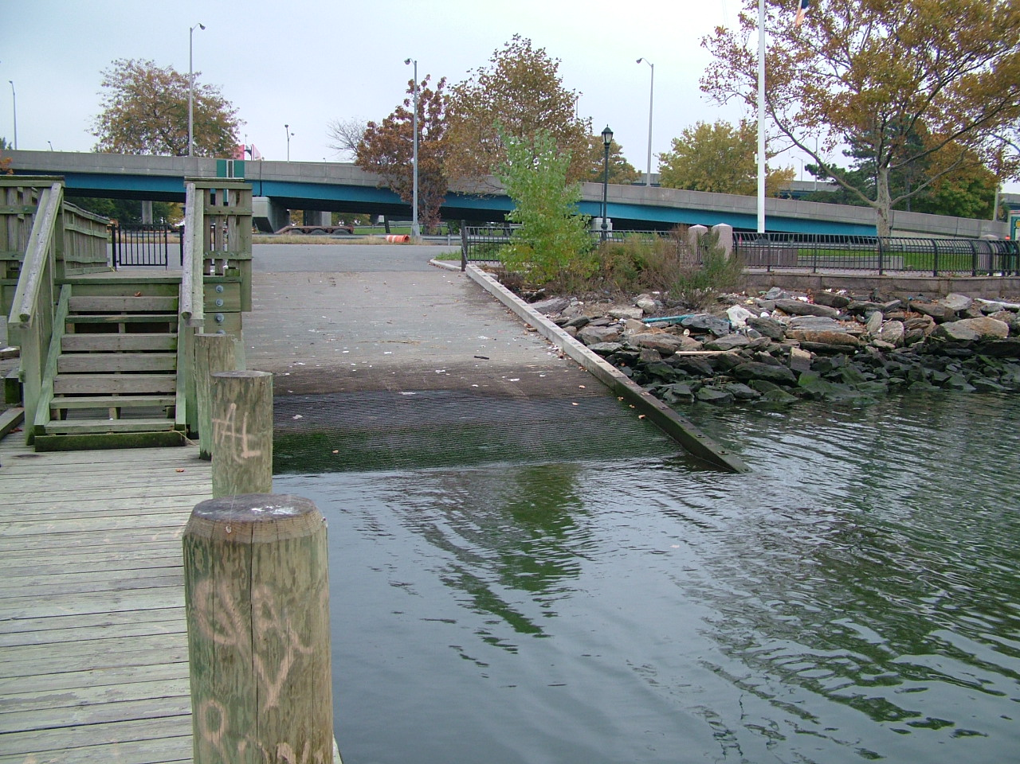
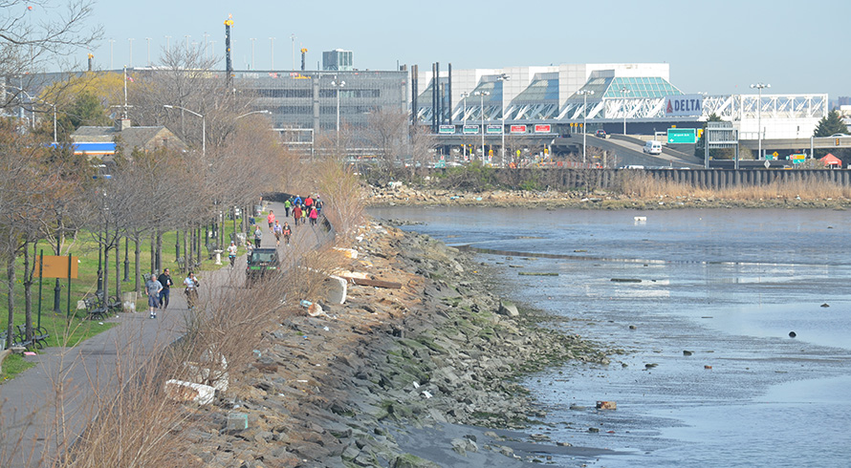
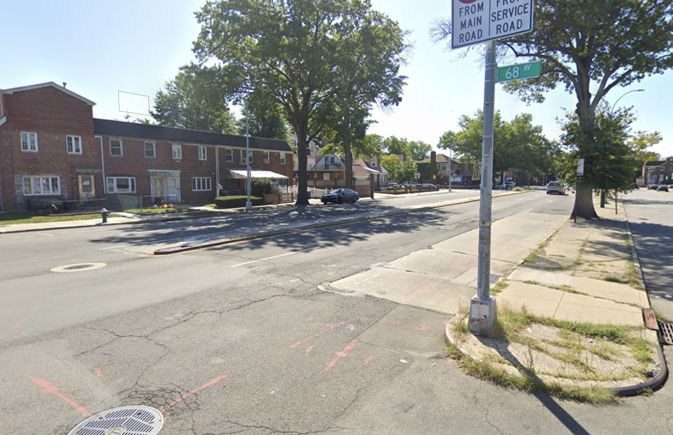
NYC Project Summary
Zoom Pop-out here
These results present a strong initial indication of wet weather contamination from the street water input into the estuarine environment.
Confirmation of Detection of L. pneumophila and serotyping of strain 1, 5, and 6. from EMLS laboratory.
Notes:
Current New York City actionable limits for Legionella concentrations in non potable water are ≥10 per milliliter, with which these results then point toward a potential area of concern.

Slide 14
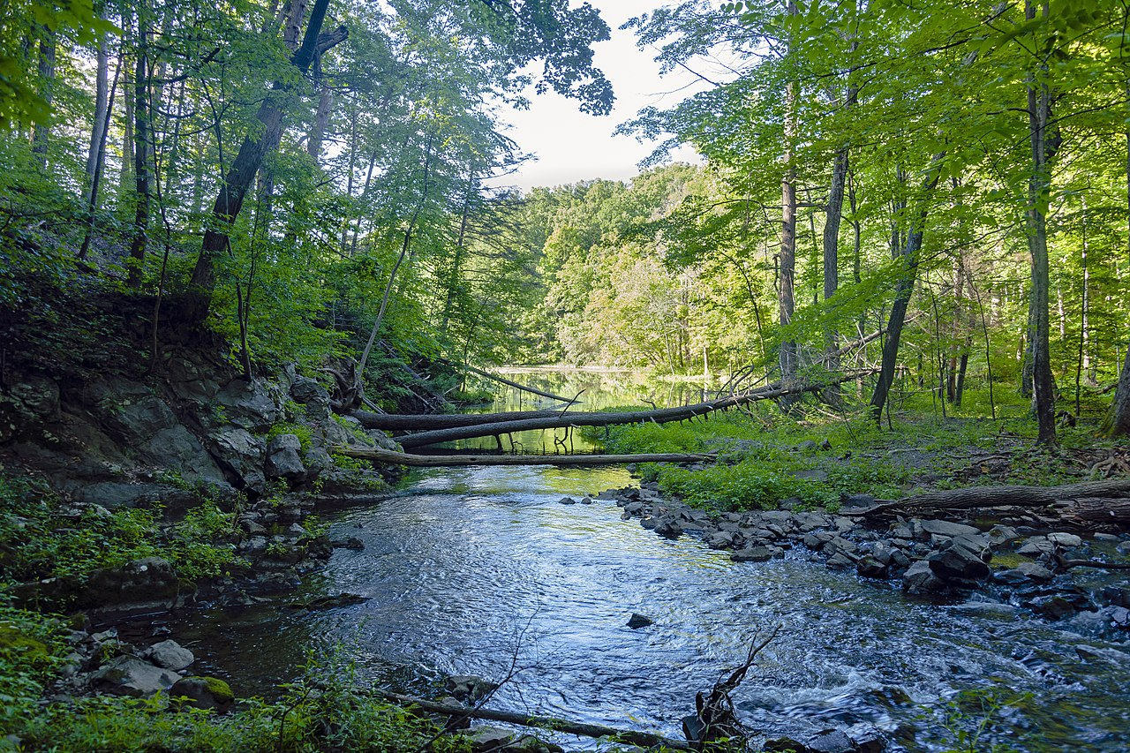
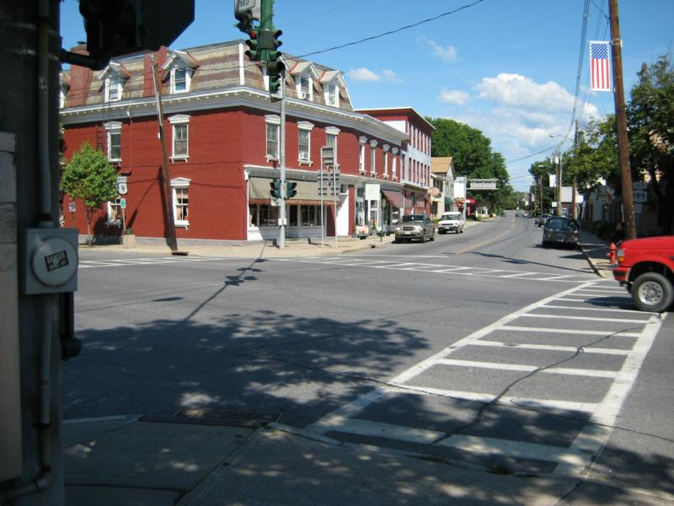
Upper Hudson River Estuary
Project Significance
Zoom Pop-out here
These data provide a unique contribution to the larger literature on Legionella ecology.
The preliminary data indicated that stormwater was a major source to waterways, it is not clear if this is restricted to urban environments or more broadly applicable.
Notes:
=

Slide 15
Hudson River Estuary Project Objectives
Zoom Pop-out here
Determine if Legionella can be detected in the freshwater Hudson River shoreline environment:
  a) Sample and analyze suburban and rural streetwater (in the Sawkill watershed).
  b) Sample and analyze a freshwater tributary of the Hudson River (Sawkill Creek).
  c) Sample shoreline and mid-channel Hudson River samples proximal to Bard College.
Determine if the concentration of Legionella is influenced by CSO and stormwater input to a small Hudson River tributary (Sawkill):
  a) Gather and analyze samples in both dry and wet weather conditions.
  b) Analyze water samples above and below, a CSO outflow pipe.
  c) Sample in CSO and direct stormwater discharge to the Sawkill.
Compare patterns of Legionella in differing Hudson River environments
  a) Compare data in suburban/rural vs urban streetwater
  b) Compare samples from freshwater vs saline components of the HRE.
COVID-19
Notes:
It is important to note the reality of the circumstances surrounding this current project.
In addition to safety established in the laboratory in working with Legionella, safety measures outside the lab were also thoughtfully planned and executed.
A current limitation to the project has been the ability to run genetic analysis:
Due to COVID-19, PCR has been limited by the supply of primers.
Therefore, the genetic analysis component to this project remains constrained at the moment.

Slide 16
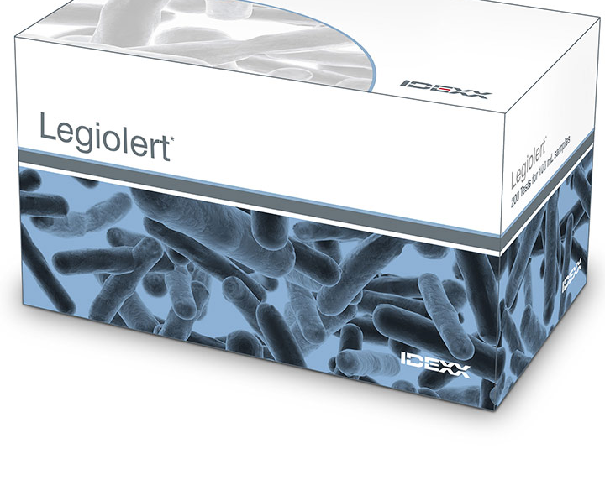
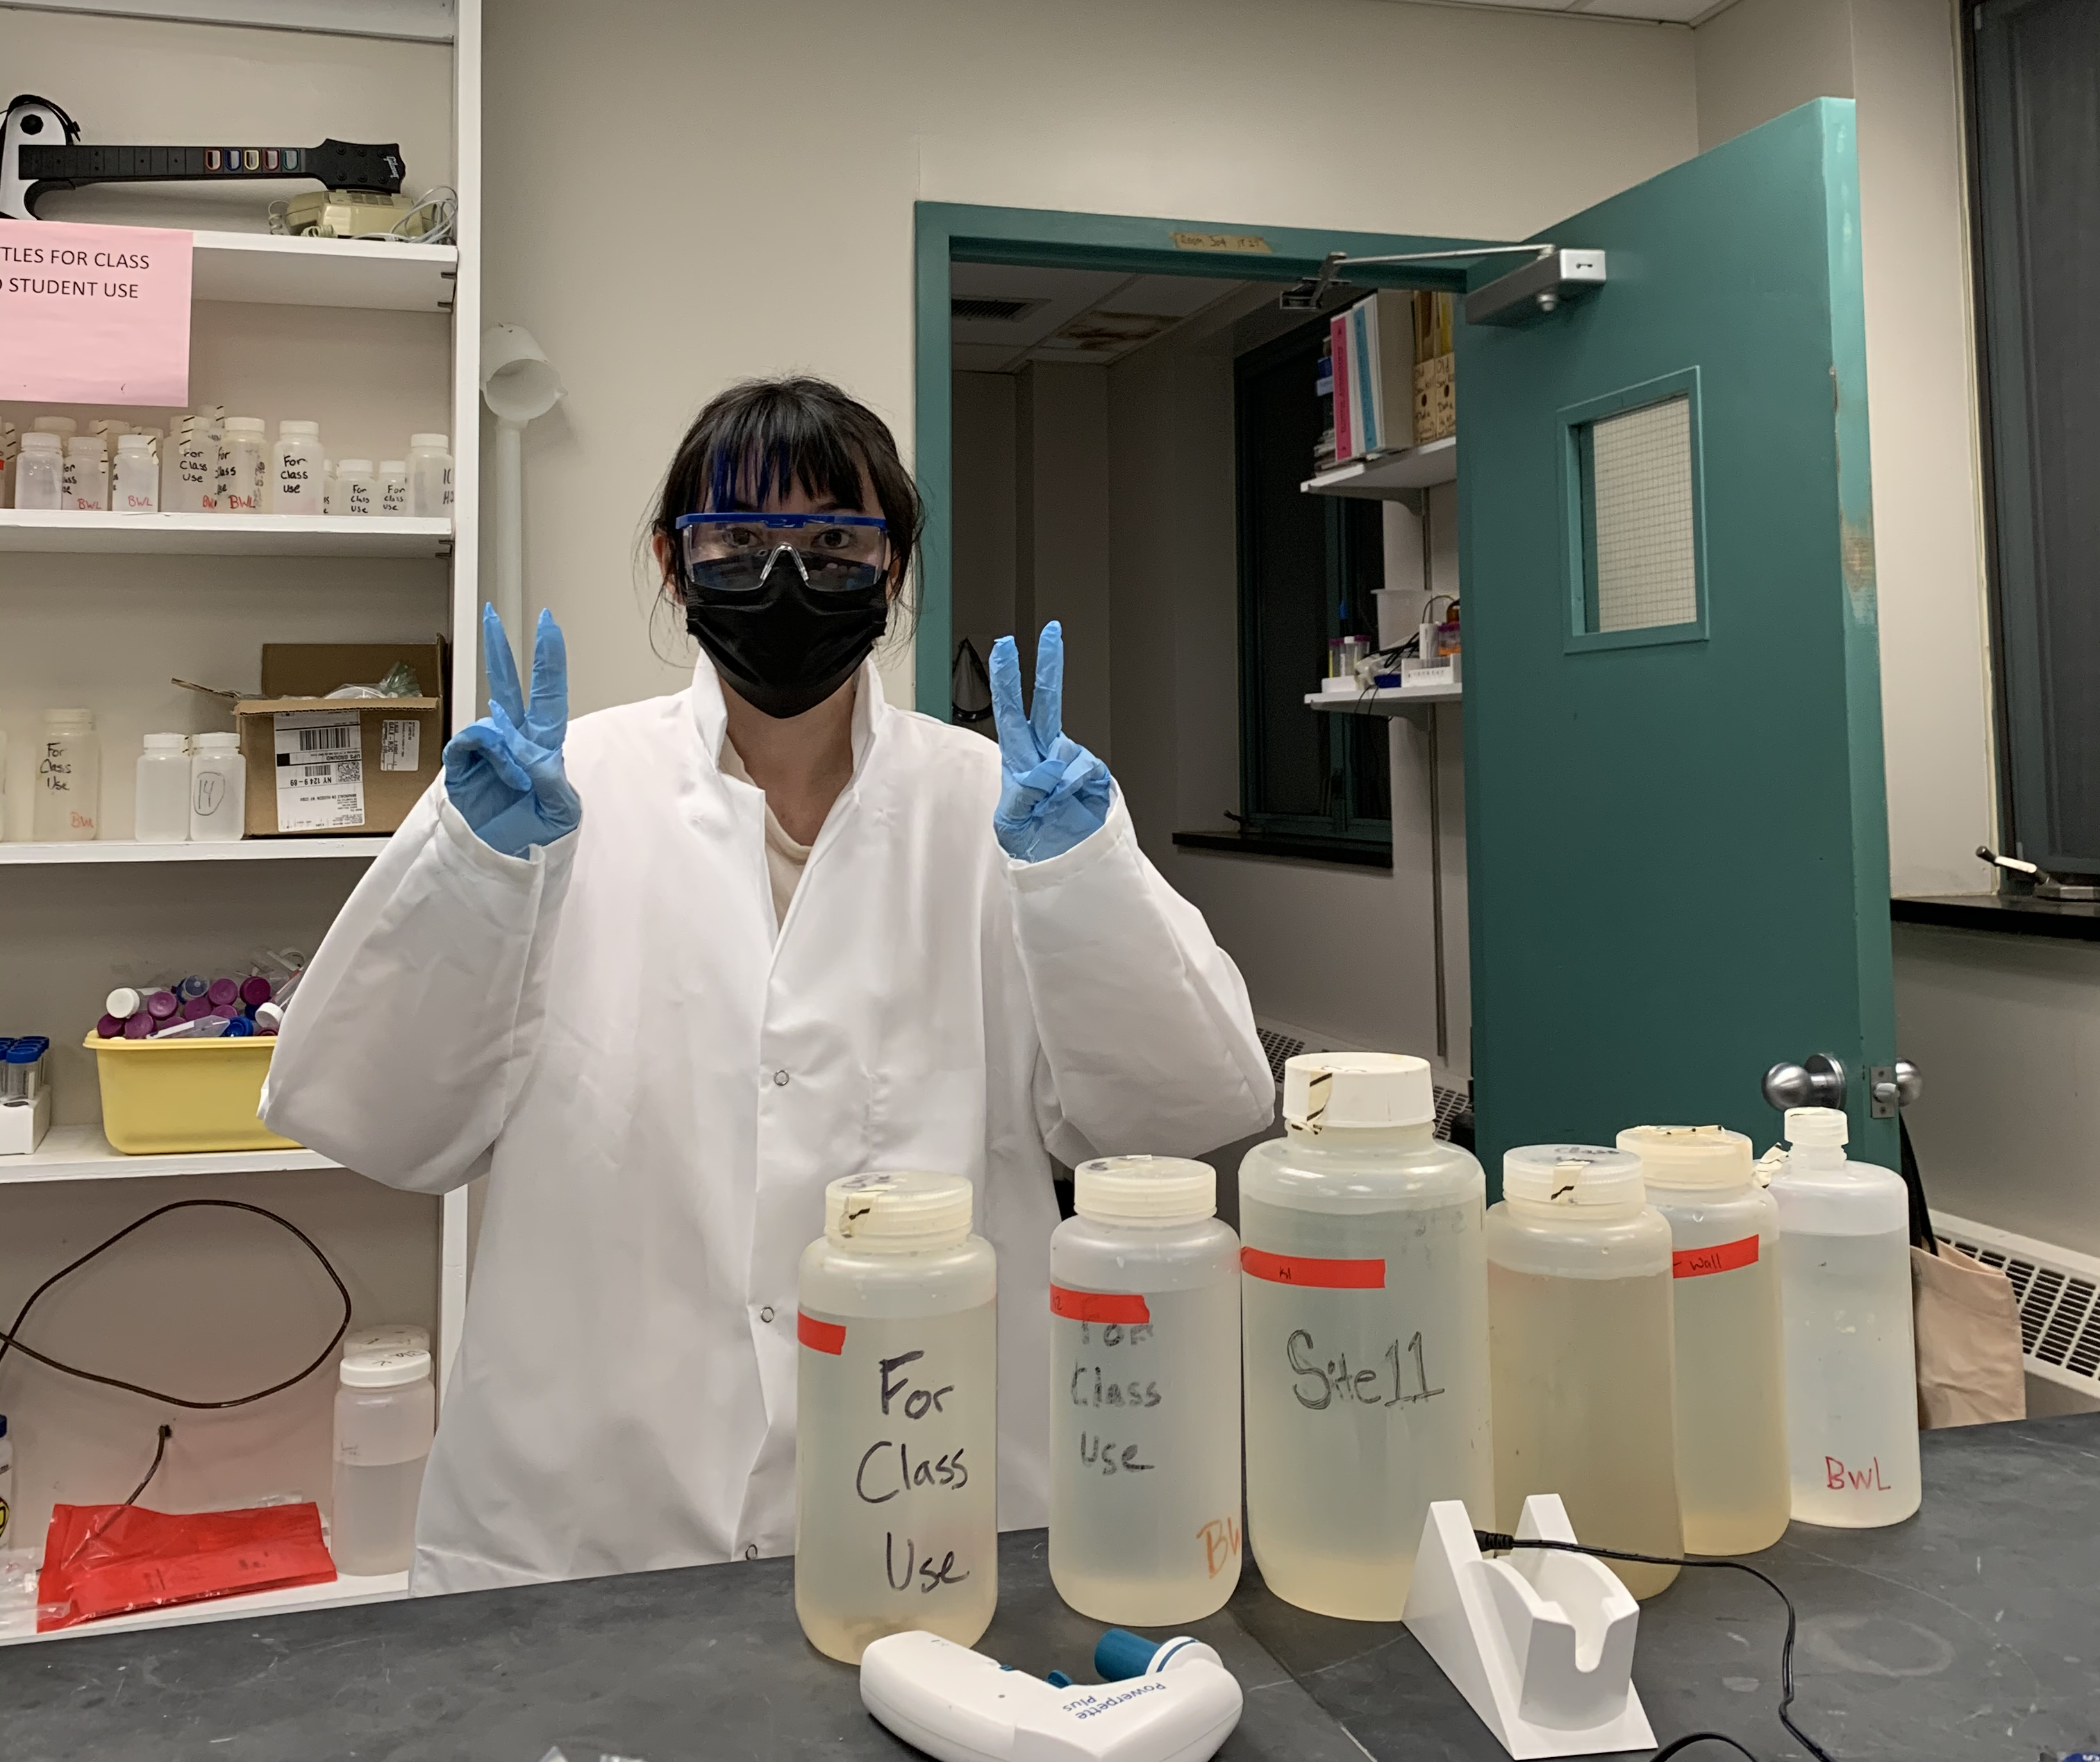
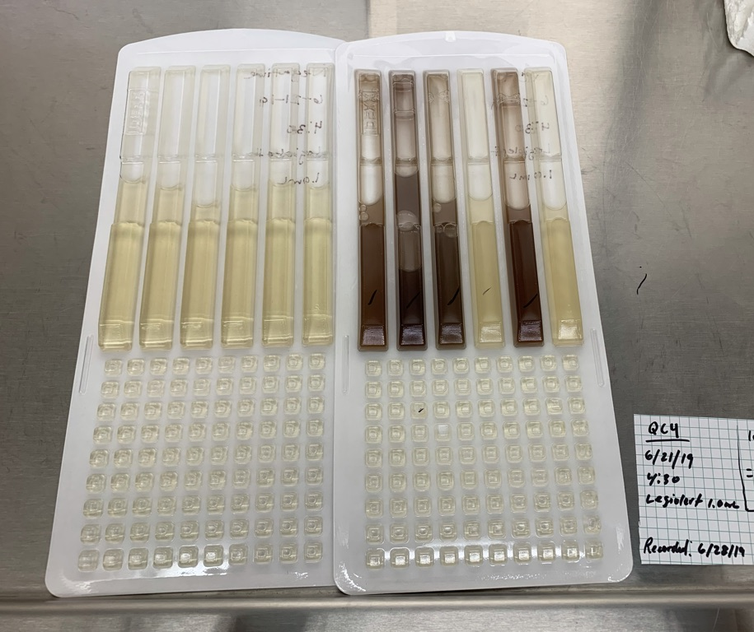
Fall 2020 Sampling Methods
Zoom Pop-out here
A total of 12 sites were regularly sampled from September 2020 to November 2020.
  4 Estuarine sites
  5 Street water sites
To enumerate total Legionella pneumophila in water samples, Legiolert, a culture method (IDEXX Laboratories, Westbrook, ME) based on a most probable number approach, will be utilized.
Parallel Enterolert, Coliform, and E.coli assays were run in the Dueker lab. DNA also collected throughout sampling.
Main Objective: To determine if L. pneumophila is present in suburban street water and freshwater Hudson River waterways in lower density areas.

Slide 17
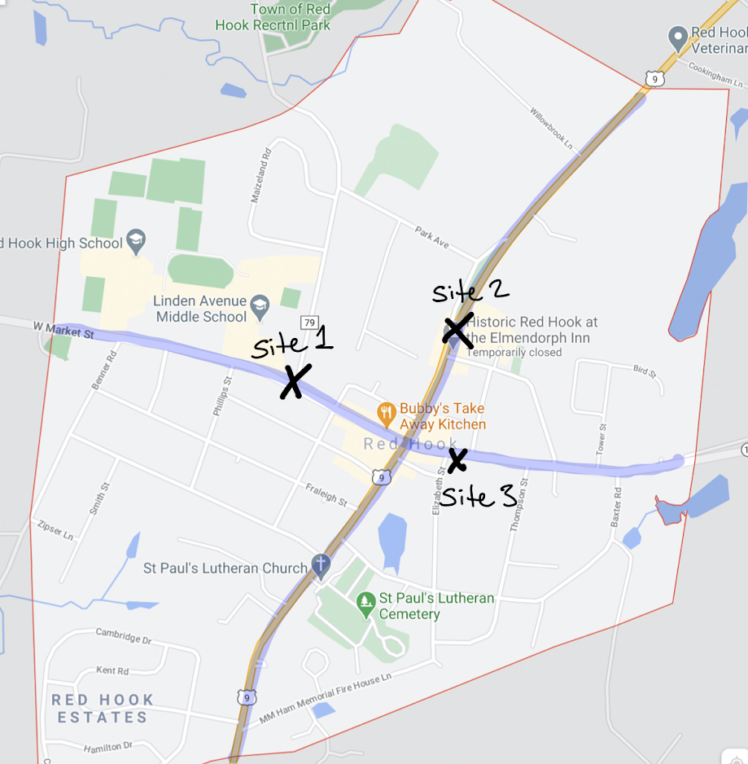
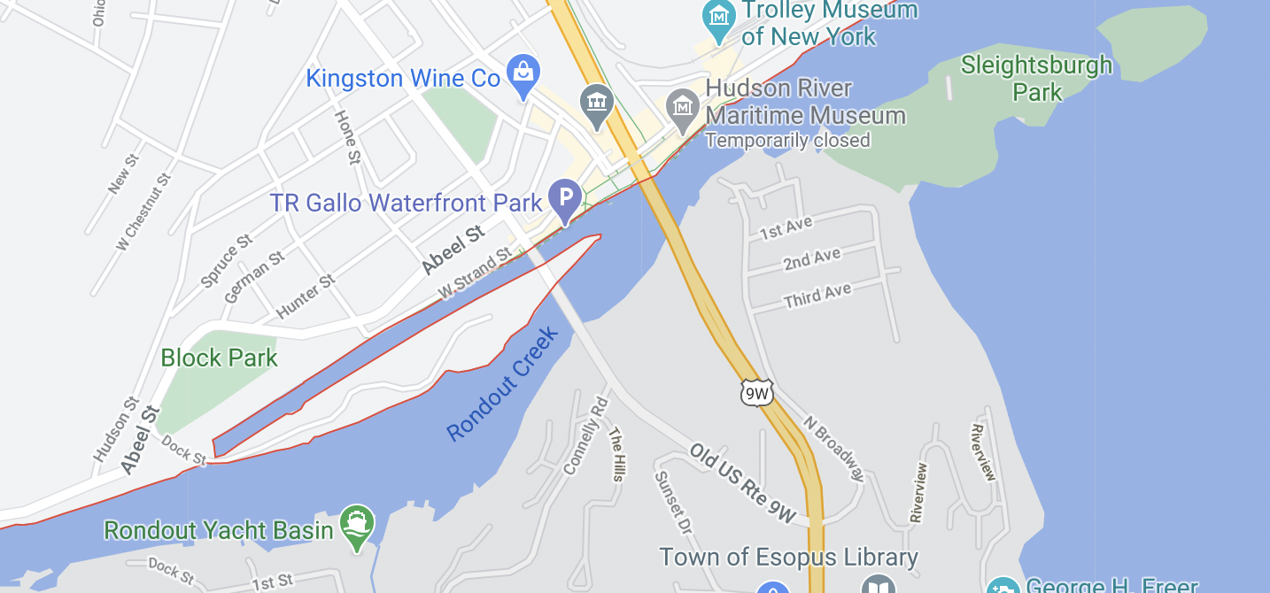
Could we detect it in suburban street water and freshwater waterways in lower population density areas?
Zoom Pop-out here
L. Pneumophila was detected in 22 % of estuarine samples. Whereas the bacteria were detected in 88% of street water samples.
K2
K3
K1

Slide 18
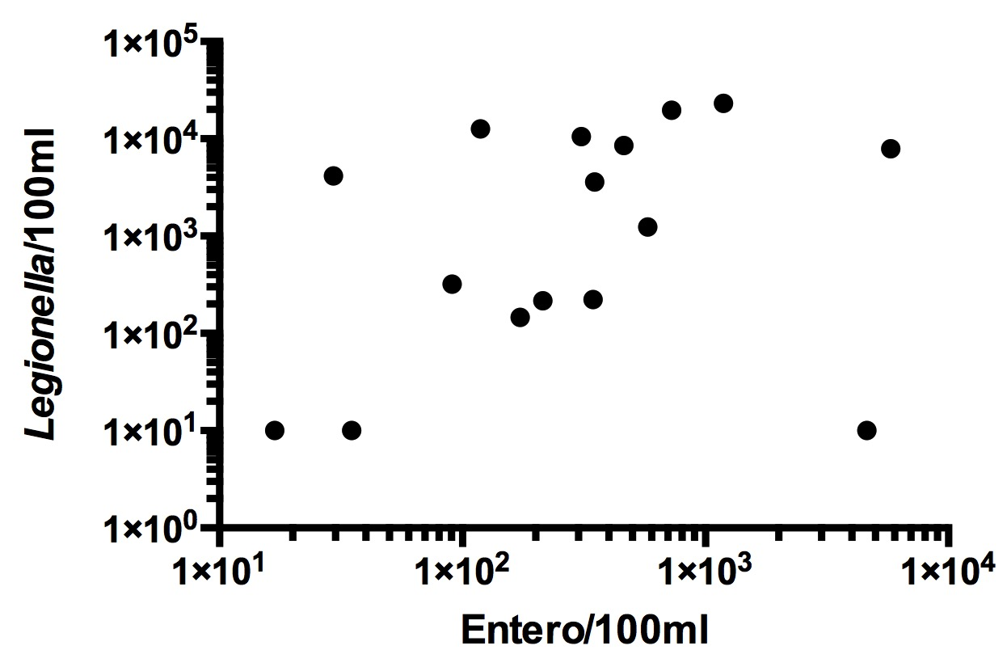
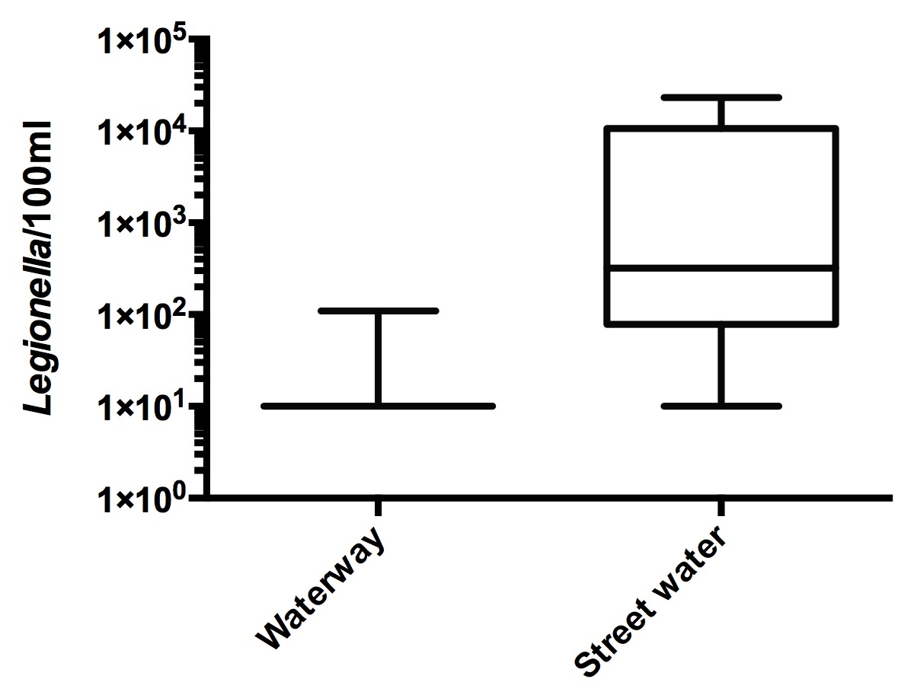
We did detect it...
Zoom Pop-out here
Suburban street water Legionella vs Enterococcus.
Spearman r= 0.384, p=0.14. Not significantly correlated
Suburban street water vs Upper HRE waterways
Street water is significantly different than waterway, p<0.01
Notes:
FIB was abundant.

Slide 19
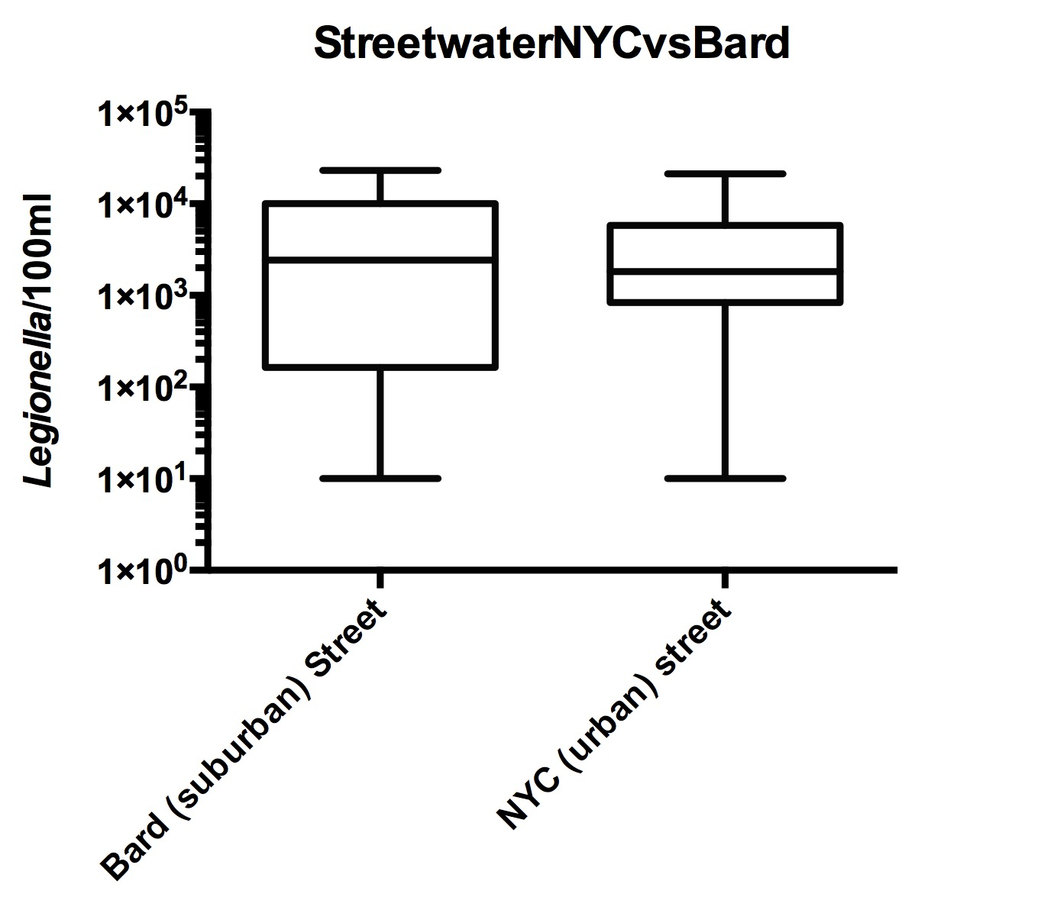
NYC vs Suburban L. pnuemophila occurrence
Zoom Pop-out here
Bard area vs NYC street water
Not significantly different, p=0.79

Slide 20
Conclusion and Next Steps
Zoom Pop-out here
The findings from these investigations revealed a widespread occurrence of Legionella, including places not previously thought to harbor the bacteria.
More data to come: Ongoing work and next steps include molecular analysis and confirmation of L. pneumophila in HRE samples.
Ongoing work also includes investigation of soil and sand samples for presence of bacteria.
NOT A CAUSE FOR PANIC!!
Reminder of other confirmed sources: soils, lakes, cooling towers, wastewater treatment plants, and aerated waterways
These results reinforce stormwater as a microbial concern and reinforces management of aerosolization sources.

Slide 21


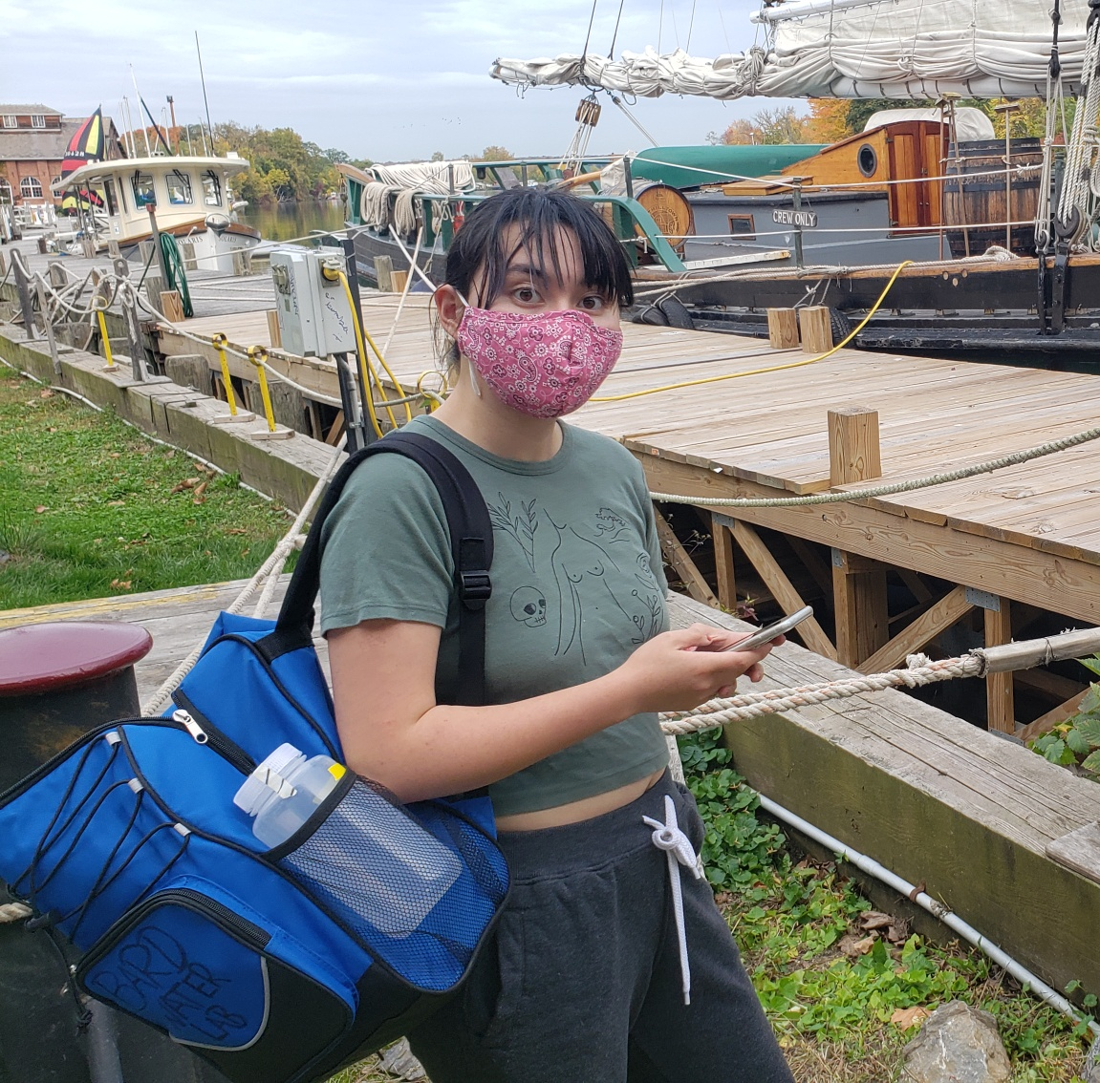

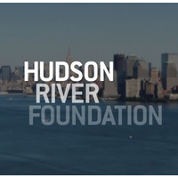
Acknowledgements
Big thank you to the following people:
Greg O’Mullan
Eli Dueker and the Dueker Lab
Grace Carter, Bard College Senior

