Slide 1
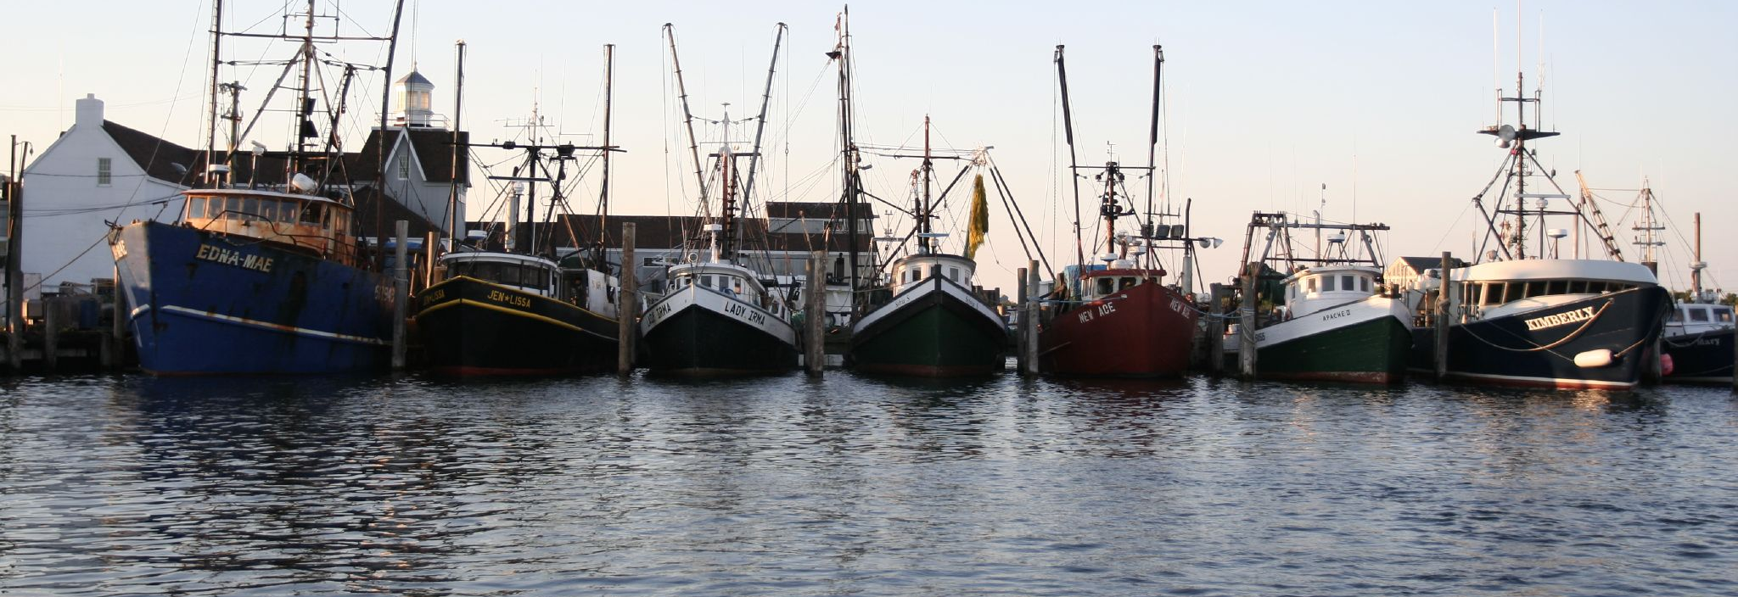
Contribution of the Hudson River
Striped Bass Population to the Mixed Coastal Recreational Harvest at Montauk Point, NY
Eva Hasegawa
New York University School of Medicine
Supervisor: Dr. Isaac Wirgin
Photo: Lian Chang, Flickr

Slide 2
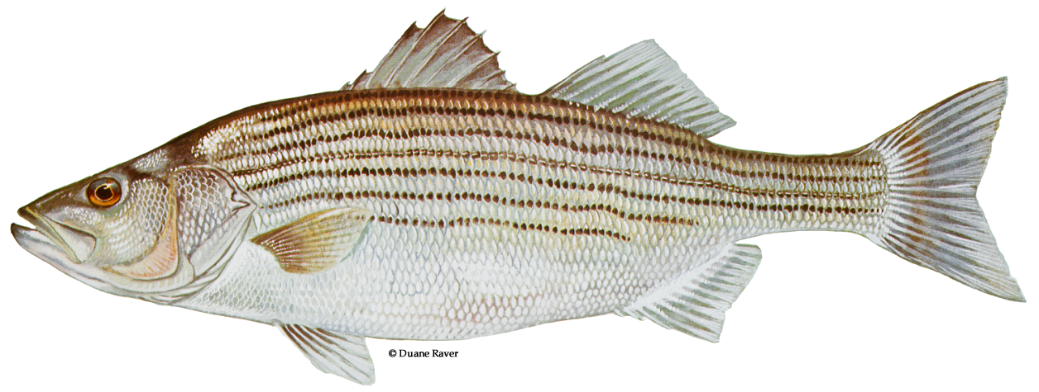
Striped Bass, Morone saxitilis (Walbaum, 1792)
Anadromous
  Spawns in major estuaries from Florida to the Gulf of St. Lawrence
Populations in the center of its distribution are highly migratory along the US Atlantic coast from North Carolina to Maine
  Hudson River, Delaware River, Chesapeake Bay, and Roanoke River
Tertiary consumer
Photo: Duane Raver, US Fish & Wildlife Service

Slide 3
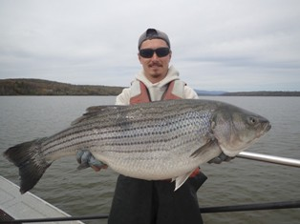
Importance to Fisheries
Supports seasonal recreational fishery and charter fishing operations in
  Hudson River
  Coastal Atlantic waters
$7.8 billion toward the US gross domestic product (GDP) (Southwick Associates 2019)
  Recreational fisheries accounted for 98% of the total
$1.165 billion added to NY’s gross GDP by the recreational fishery in 2016 (Southwick Associates 2019)
Photo: New York Department of Environmental Conservation

Slide 4
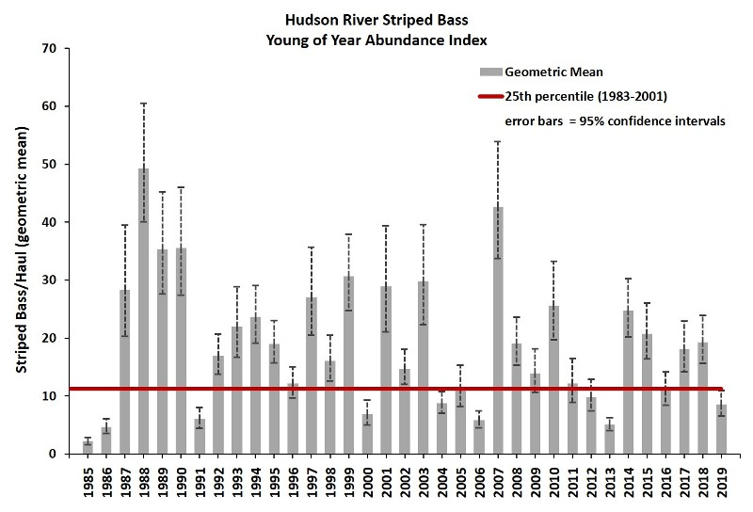
Past and Current States of the Fishery
Then:
Stock collapsed in 1970s due to overfishing and habitat degradation
  Hudson River commercial fishery closed in 1976 due to elevated PCB levels
Coastwide harvest moratorium successfully restored stocks by the early 1990s
  Amendment imposed to protect 1982 year class
Now:
Atlantic States Marine Fisheries Commission (ASMFC) declared stock overfished and overfishing is occurring
ASMFC implemented harvest cuts in 2020
Reproductive success of striped bass in the Hudson River (Young of Year Striped Bass Abundance, NYSDEC).

Slide 5

Aims of Study
Determine the contribution of Hudson River striped bass population to the Montauk Point recreational fishery of 2019.
Inform fisheries managers on presence of major contributors that are reproductively isolated and vary in growth, maturation, mortality rates, recruitment success, migratory behavior, and exploitation.
Hypotheses
1) We will find a smaller contribution of the Hudson River population to the Montauk mixed stock recreational striped bass fishery in 2019 than observed by Berggren and Lieberman (1978).
2) Proportional contributions to the coastal migratory stock have changed over time based on differing relative recruitment success in the contributing populations.

Slide 6
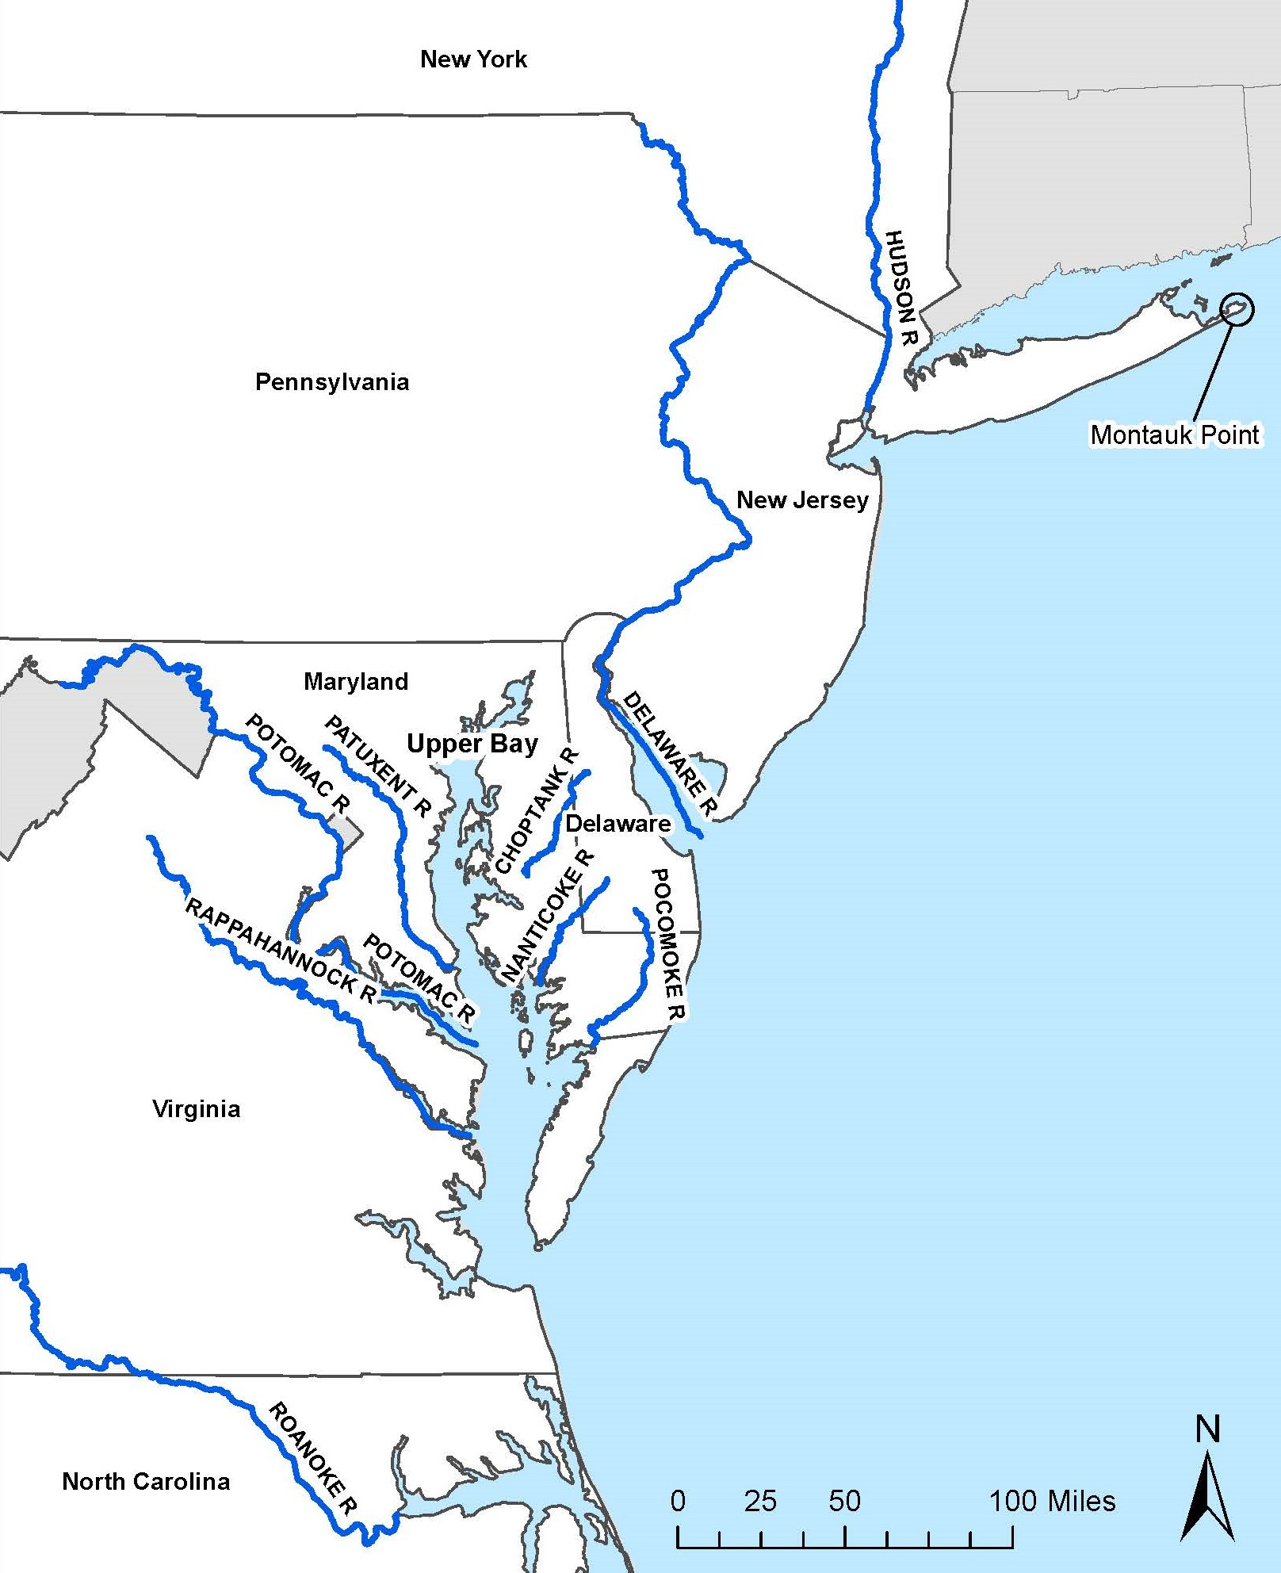
Methods: Sampling Locations
At Montauk Point: 410 adult striped bass collected by angling weekly from June 23 through Oct 31, 2019
  Provided by Capt. Burt Prince of the Montauk charter boat, Susie E.
  Fin clips collected
Reference specimens collected in past years from spawning stocks (adults or YOY) in the Hudson River, Roanoke River, Delaware River, and major tributaries of the Chesapeake Bay
  Patuxent, Potomac, Rappahannock, Choptank, Nanticoke, Pocomoke, and Upper Bay
Map References: US Census 2019 Cartographic Boundary Files, Rivers of the US (National Operational Hydrologic Remote Sensing Center)

Slide 7
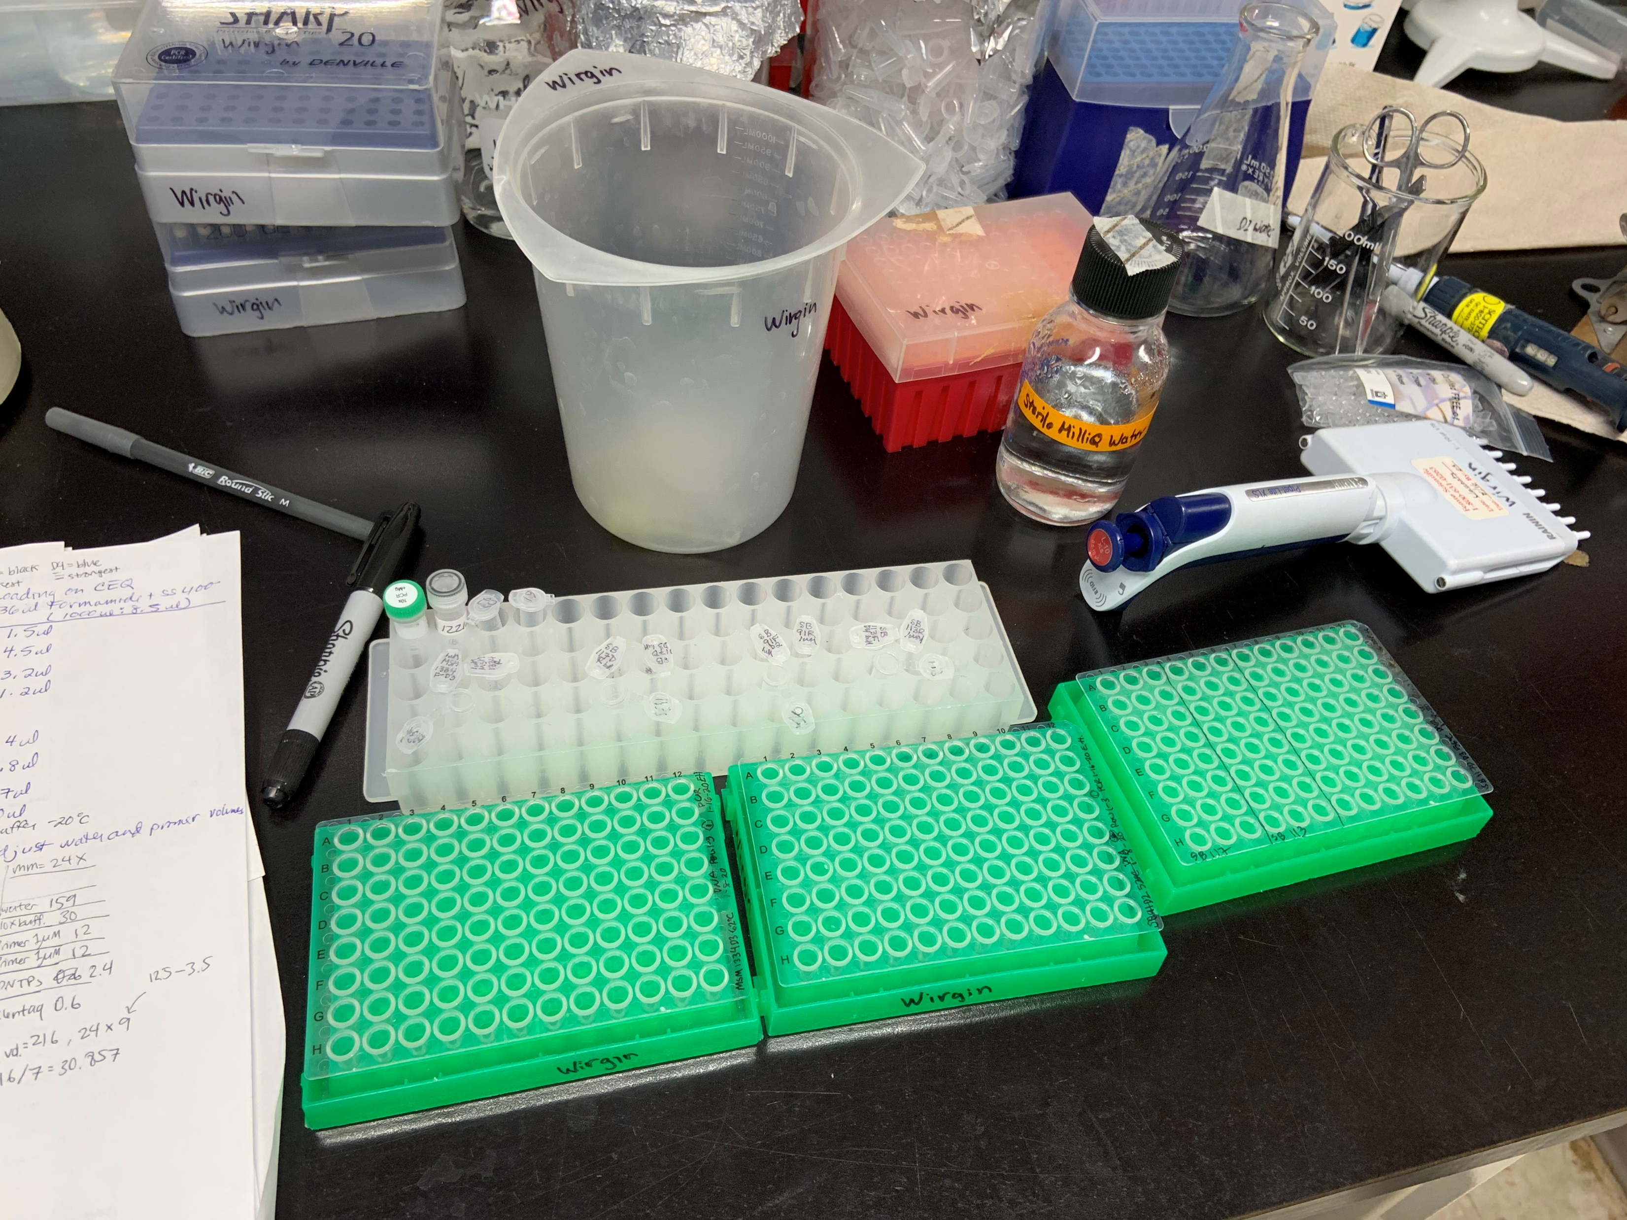
Methods: DNA Isolation, PCR
DNA Isolation:
Fin clips stored in 95% ethanol, underwent digestion with proteinase K, phenol-chloroform extractions, and alcohol precipitations.
DNA concentrations read with Nanodrop ND-100 spectrophotometer
Polymerase Chain Reaction (PCR):
Eight established microsatellite loci: SB91, SB113, SB117D, MSM1334, MSM1357, MSM1584, SB108, and MSM1598
Four new loci: MSM1626, MSM1557, MSM1556, and MSM1592 (Rexroad et al., 2006)

Slide 8
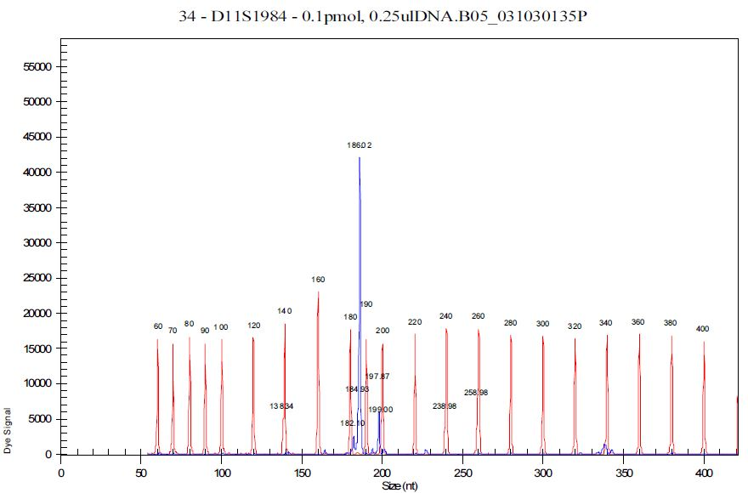
Methods: Genotype Characterization and Statistics
Statistics:
GENEPOP version 4.1.0 (Rousset, 2008) – measures departures from Hardy-Weinberg equilibrium and linkage disequilibrium
GenoDive V.20b27 (Meirmans and Van Tienderen, 2004) – pairwise differentiation between populations
Structure 2.3.4 (Pritchard et al. 2000a) – population clustering
ONCOR (Kalinowski et al., 2008) – Mixed-Stock Analysis (MSA) and assignment accuracy
GeneClass2 (Piry et al. 2004) – Individual-Based Assignment (IBA) testing
Photo: Beckman Coulter CEQ 8000 User’s Guide
Used Beckman Coulter CEQ 8000 capillary-based DNA sequencer to measure PCR fragment lengths
Each fragment length corresponds to an allele

Slide 9
Results: Loci Characteristics: Plenty of Alleles to Distinguish Populations
Name | Number of Alleles | Effective Number of Alleles | Fst
SB113D4 | 40 | 15.7 | 0.006327
MSM1556D3 | 33 | 14.5 | 0.00501
MSM1626D4 | 30 | 11.9 | 0.006594
MSM1592D4 | 25 | 10.3 | 0.007139
SB117DD3 | 24 | 4.3 | 0.028814
MSM108D2 | 22 | 7.0 | 0.005775
MSM1557D3 | 20 | 7.3 | 0.020455
MSM1334D3 | 19 | 8.0 | 0.00348
MSM1584D3 | 19 | 8.9 | 0.003658
MSM1357D4 | 19 | 8.0 | 0.008987
MSM1598D2 | 16 | 7.1 | 0.017515
SB91D2 | 13 | 4.0 | 0.012302
Effective number of alleles: number of alleles with same frequencies
Fst: measure of genetic differences among populations

Slide 10
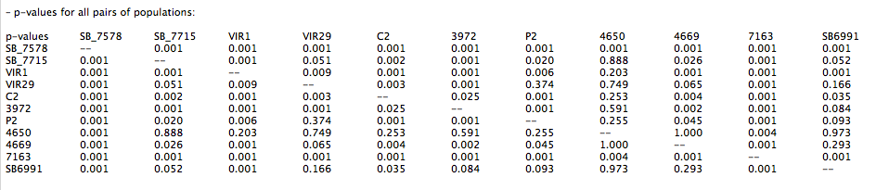
Results: F’st Analysis Showed Highly Significant Differences Among Hudson, Delaware, Pooled Chesapeake, and Roanoke Populations; No differences between Delaware and Chesapeake Populations
= Hudson River
= Roanoke River

Slide 11
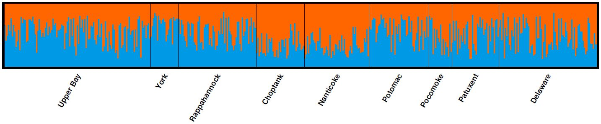
Results: STRUCTURE Analysis of Number of Genetic Clusters Using 12 Loci
Among 11 sampling collections, we found 3 major populations
Delaware specimens are not genetically different from Chesapeake specimens
2 distinct clusters found in Chesapeake collections (Choptank and Nanticoke in one cluster?)

Slide 12
Results: Assignment Accuracy Back to Collection Site was High Using 12 Loci
Population | Assignment Accuracy |  | 95% CI
Hudson | 0.9295 |  | (0.8630, 0.9792)
Chesapeake | 0.9645 |  | (0.9212, 0.9992)
Roanoke | 0.8055 |  | (0.7256, 0.8656)
Analyzed in Oncor
Fishery sample is simulated where all the specimens are from the same population
Measures how accurately specimens are assigned back to their sampling area
Indicates how useful the loci are in assigning specimens to baseline populations

Slide 13

Next: Assignment of Montauk fish - Why do we need to know population contributions?
Spawning success and recruitment within these populations vary temporally and is often asynchronous
They likely require differing levels of protection over time
Quantitative estimate of their contributions needed for effective management
Population origin analyses are critical in evaluating the impact of mortality in mixed coastal fisheries on individual populations such as the Hudson River

Slide 14
Results: Population Origin of Montauk Fish Using Two Methods With 8 Loci
1) Mixed Stock Analysis
Population Estimates with 95% CI
Hudson | 0.085 | (0.025, 0.167)
Chesapeake | 0.8792 | (0.766, 0.945)
Roanoke | 0.0358 | (0.000, 0.128)

Slide 15
Results: Population Origin of Montauk Fish Using Two Methods With 8 Loci
2) Individual-based Assignment
Hudson – 13.3% Chesapeake – 77.9% Roanoke – 8.8%

Slide 16
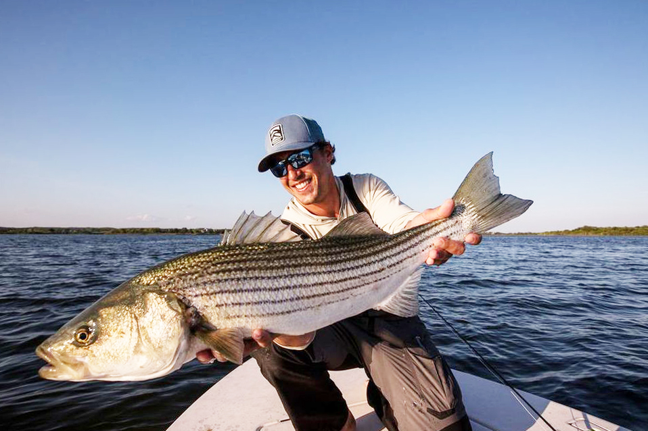
Discussion
Berggren and Lieberman (1978) estimated contributions using morphological characteristics
  6.5% Hudson, 90.8% Chesapeake, 2.7% Roanoke
Can effectively distinguish between Chesapeake, Hudson, and Roanoke fish
  The 4 new loci are good markers for population assignment
  Delaware population not genetically distinct from pooled or individual Chesapeake population
Chesapeake population is the main contributor at Montauk
  Slight difference between Nanticoke and Choptank populations compared to other Chesapeake populations
  Also observed in study using SNPs (LeBlanc et al, 2020) and microsatellite study by Wirgin et al, 2020
Photo: https://fishingbooker.com/blog/long-island-striped-bass-fishing-all-you-need-to-know/

Slide 17

Next Steps
Complete genotyping of the remainder of the 410 Montauk specimens with all 12 loci
Do Mixed Stock Analysis and Individual Based Assignment testing of the complete Montauk collection
Compare population origin of Montauk specimens
  Collected in different time periods
  Of different sizes

Slide 18
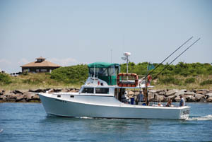
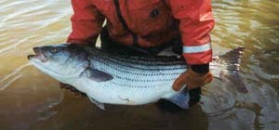
Acknowledgements
Supervisor: Dr. Isaac Wirgin
Lab: Lorraine Maceda
Lab: Dr. Nirmal K. Roy
Specimens: Captain Burt Prince and the crew of the Susie E II
Fin clip collection: Burt’s son Justin Prince
Hudson River Foundation
Photo: https://www.susiee.com/a-montauk-charter-boat-ideal-for-fishing-charters-social-functions/
Photo: https://www.dec.ny.gov/animals/37211.html

Slide 19
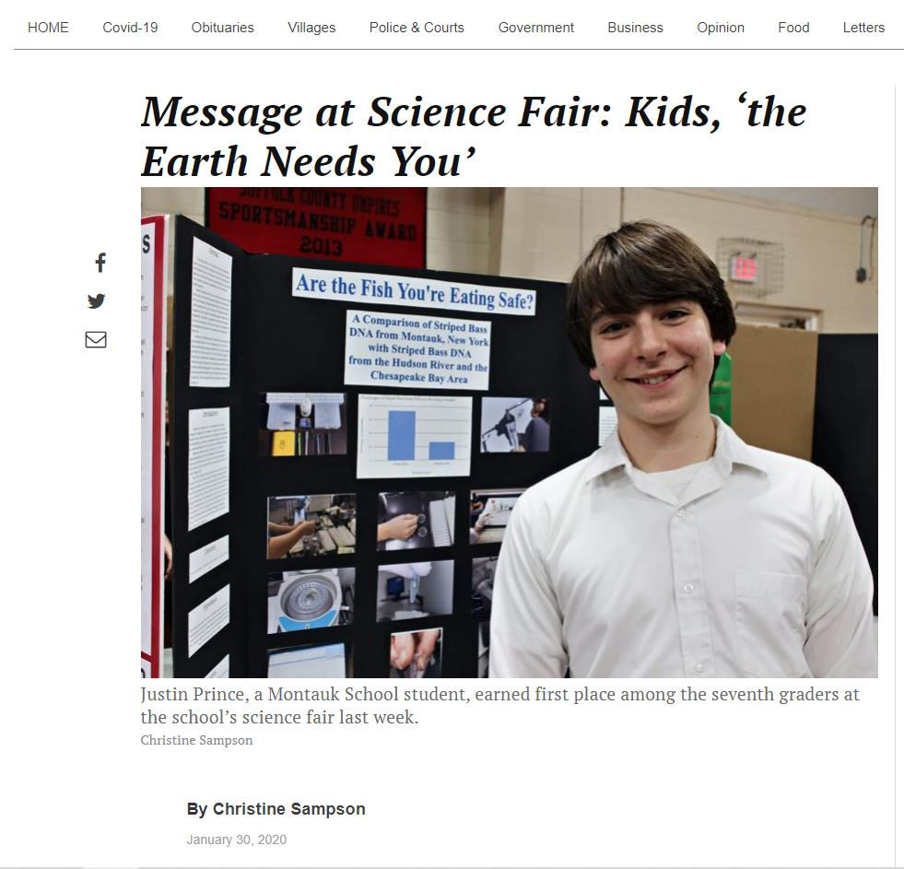
From the East Hampton Star:

Slide 20
Citations
Southwick Associates. 2019. The economic contributions of recreational and commercial striped bass fishing. The McGraw Center for Conservation Leadership. Fernandina Beach, FL.
Atlantic States Marine Fisheries Commission. 2016. Atlantic Striped Bass Stock Assessment Update. ASMFC, Arlington, VA. 100pp.
“Atlantic Striped Bass Benchmark Stock Assessment Finds Resource Overfished and Overfishing Occurring, Board Initiates Addendum to Reduce Total Fishing Mortality.” Atlantic States Marine Fisheries Commission, 1 May 2019, www.asmfc.org/
Berggren, Thomas J. and Lieberman, Joel T. 1978. “Relative contribution of Hudson, Chesapeake, and Roanoke striped bass, Morone saxatilis stocks to the Atlantic coast fishery”. Fish. Bull. 76:335-345.
Wirgin, Isaac I., Maceda, Lorraine, Tozer, Matt, Stabile, Joseph, and Waldman, John. “Atlantic Coastwide Population Structure of Striped Bass Morone saxatilis Using Microsatellite DNA Analysis.” Fisheries Research, vol. 226, 16 Jan. 2020, pp. 1–13., doi:10.1016/j.fishres.2020.105506.
Rexroad, Caird, et al. “Identification and Characterization of Microsatellites for Striped Bass from Repeat-Enriched Libraries.” Conservation Genetics, vol. 7, no. 6, Dec. 2006, pp. 971–982., doi:10.1007/s10592-006-9122-0.
Rousset, F. 2008. GENEPOP ‘007: a complete re-implementation of the GENEPOP software for Windows and Linux. Mol. Ecol. Notes. 8:103-106.
Meirmans, P.G. (2020), GENODIVE version 3.0: Easy-to-use software for the analysis of genetic data of diploids and polyploids, Molecular Ecology Resources DOI: 10.1111/1755-0998.13145.
Pritchard J. K., Stephens M., Donnelly P. (2000a). Inference of population structure using multilocus genotype data. Genetics 155, 945–959
Kalinowski, S.T., K.R. Manlove, and M.L. Taper. 2008. ONCOR: A computer program for genetic stock identification. Montana State University. Bozeman, MT.
Piry, S., A. Alapetite, J-M. Cornuet, D. Paetkau, L. Baudouin, and A. Estoup. 2004. GENECLASS2: A software for genetic assignment and first-generation migrant detection. J. Heredity 95:536-539.

